Slide 1
Virtualization workshop
Demystifying Virtualization: From Popek & Goldberg to MicroVMs
Notes:
Notes:
initial research
The meeting goal is to share / synch – think what question do we want to ask and answer?
Followup will be to determine follow up research / possible defensive measure development

Slide 2

Why are we here?
Abstract Goals
Demystify virtualization
Practical grasp on virtualization for future research
Full-Stack intro to MicroVMs
Technical Goals
Virtualization A-Z in a nutshell
KVM MicroVMs internals
DevOps use cases
Perspective
Security boundaries
Vs Containers
Performance
What’s in store?

Slide 3

What’s in store?
Part I: Virtualization Intro - 40min
Definitions and Context: [(20min)] + Hands On: [(20min)]
Break – 10min
Part II: KVM MicroVMs - 1hr
User, Kernel and HW: [(20min)] + Hands On: [(40min)]
Break – 20min
Part III: Firecracker - 40min
Firecracker: [(20min)] + Hands On: [(20min)]
Break – 10min
Part IV: DevOps Use Cases - 1hr
DevOps Use Cases: [(20min)] + Hands On: [(40min)]
What’s in store?

Slide 4
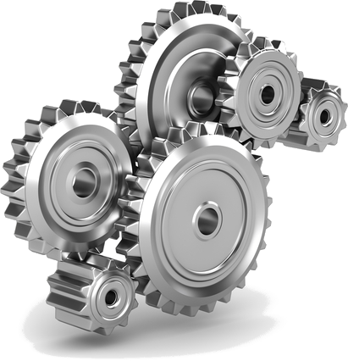
How’s it gonna work?
Requirements
Decent Bare-Metal with VTx
Ubuntu VM on VMWare
Materials
Slides + PDF
Hands on files
Hands on scripts
Concepts
Self explanatory
Minimum required words
Theory vs Hands on: 50/50 Interlaced
What’s in store?

Slide 5
Part I Virtualization Intro

Slide 6

Topics
Intro
Types
MicroVMs
Containers Context
MicroVMs Use Cases
Security Boundaries
Virtualization Intro (Theory)

Slide 7

Intro
Timeline of major events
1966 – IBM CP-40: Full Virtualization
1972 – IBM System/370: HW Assisted Virtualization
1974 – Popek & Goldberg define Virtualization
1979 – Unix V7: Chroot
1999 – Vmware Virtual Platform for the Intel IA-32 architecture
2000 – FreeBSD 4.0 + FreeBSD jails
2002 – Linux Namespaces
2003 – Xen: first open source hypervisor for x86
2004 – Solaris Containers
2005 – Intel VTx and AMD-V: HW Assisted Virtualization
2005 – Seccomp
2006 – Vmware Server
2006 – cgroups (Process Containers)
2007 – Open source KVM
2007 – VirtualBox
2008 – LXC: cgroups + linux namespaces
2011 – QEMU
2013 – Docker
2014 – K8s
2017 – Containers adopted by CNCF
2018 – Firecracker: AWS Announce release @ re:Invent
Virtualization Intro (Theory)
Notes:
References:
https://en.wikipedia.org/wiki/Timeline_of_virtualization_development
https://docs.oracle.com/cd/E26996_01/E18549/html/VMUSG1010.html
https://blog.aquasec.com/a-brief-history-of-containers-from-1970s-chroot-to-docker-2016

Slide 8
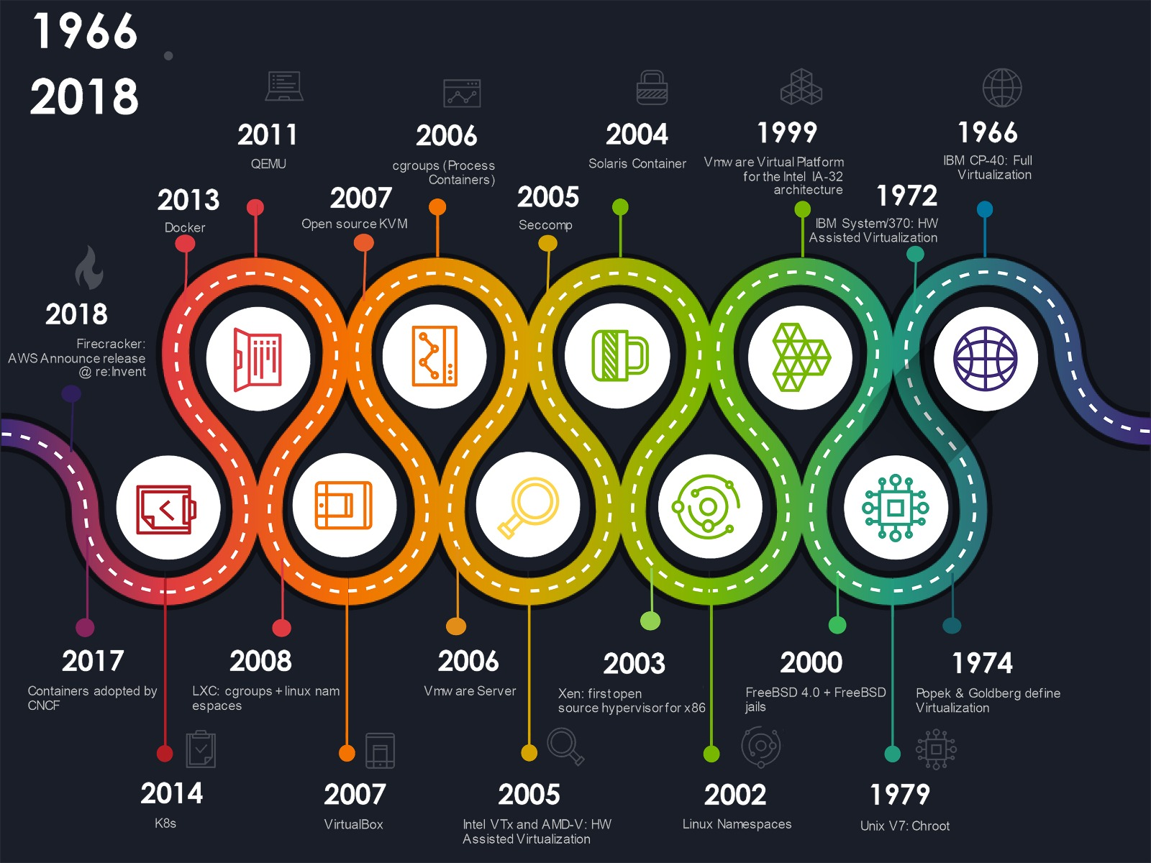
Intro
Virtualization Intro (Theory)
Notes:
References:
https://en.wikipedia.org/wiki/Timeline_of_virtualization_development
https://docs.oracle.com/cd/E26996_01/E18549/html/VMUSG1010.html
https://blog.aquasec.com/a-brief-history-of-containers-from-1970s-chroot-to-docker-2016

Slide 9
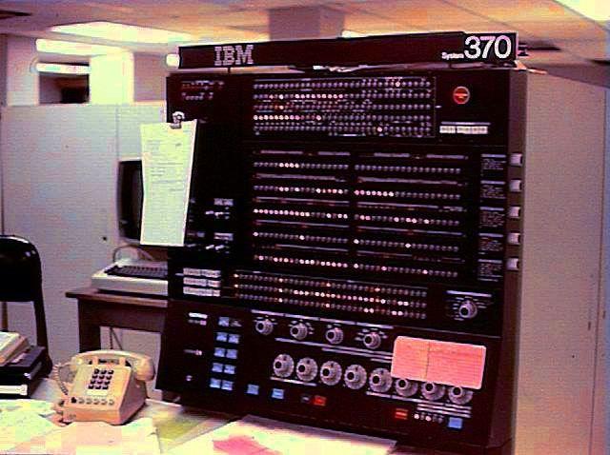
Intro
Virtualization Intro (Theory)
Notes:
References:
https://en.wikipedia.org/wiki/Timeline_of_virtualization_development
https://docs.oracle.com/cd/E26996_01/E18549/html/VMUSG1010.html
https://blog.aquasec.com/a-brief-history-of-containers-from-1970s-chroot-to-docker-2016

Slide 10

intro
What’s A VM?
An abstraction and isolation of computer resources
Hypervisor is the brain that manages virtual resources
Why Bother?
Sandbox resources and data
Utilize maximum resources
Scalability & Portability
How’s It Done?
Isolate system resources
Abstract and Imitate real peripherals
Trap to enforce sensitive instructions
Virtualization Intro (Theory)
Notes:
References:
https://en.wikipedia.org/wiki/Timeline_of_virtualization_development
https://docs.oracle.com/cd/E26996_01/E18549/html/VMUSG1010.html
https://blog.aquasec.com/a-brief-history-of-containers-from-1970s-chroot-to-docker-2016

Slide 11
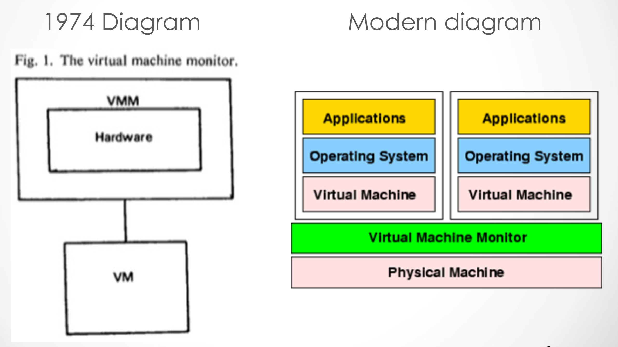
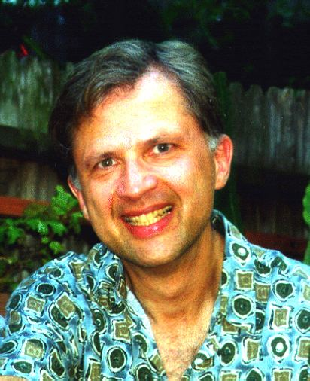
intro
VMs are capable of virtualizing a full set of hardware resources
VMM provides the abstraction of a virtual machine
Gerald J. Popek
In 1979 published along with
Robert P. Goldberg a cornerstone article
Virtualization Intro (Theory)

Slide 12
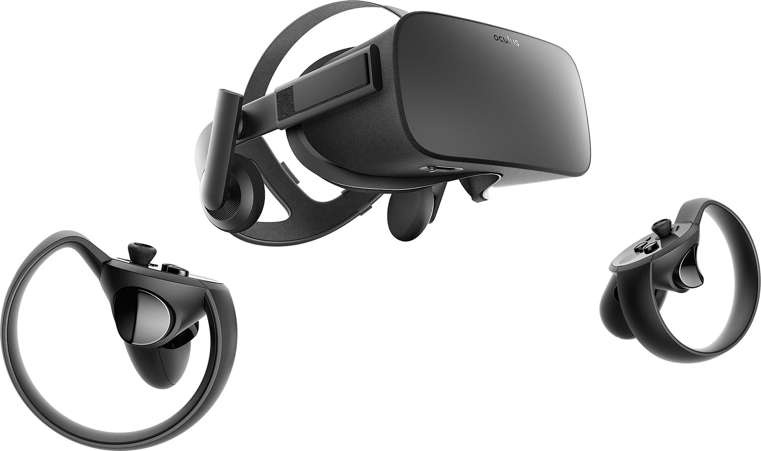
Types
Virtual Memory
Desktop Virtualization
Platform Virtualization
Storage Virtualization
Network Virtualization
Application Virtualization
Virtualization Intro (Theory)

Slide 13
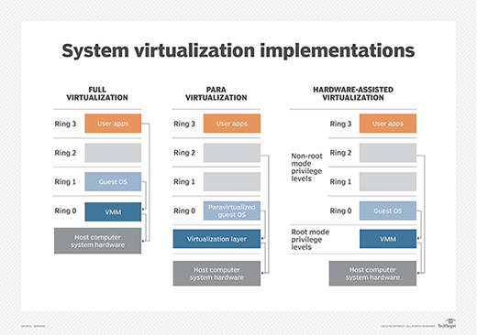
Types
Platform Virtualization Concepts:
Type I – Bare Metal
Type 2 - Hosted
Full Virtualization – Guest OS is unaware
Para-Virtualization – Guest OS is modified
Hardware Assisted Virtualization
(OS Level Virtualization – Containers share a kernel)
Virtualization Intro (Theory)

Slide 14
Types
Platform Virtualization Methods:
Intel VT-x \ AMD-V – Enforced by HW
Binary Translation
HyperCalls
(chroot, cgroups, namespaces)
Virtualization Intro (Theory)

Slide 15

Micro Vms
What’s New?
Minimal design
Reduced attack surface
High performance
Pioneers
Rust-vmm
Firecracker
Qemu micro-vm
Kata Containers
Virtualization Intro (Theory)

Slide 16
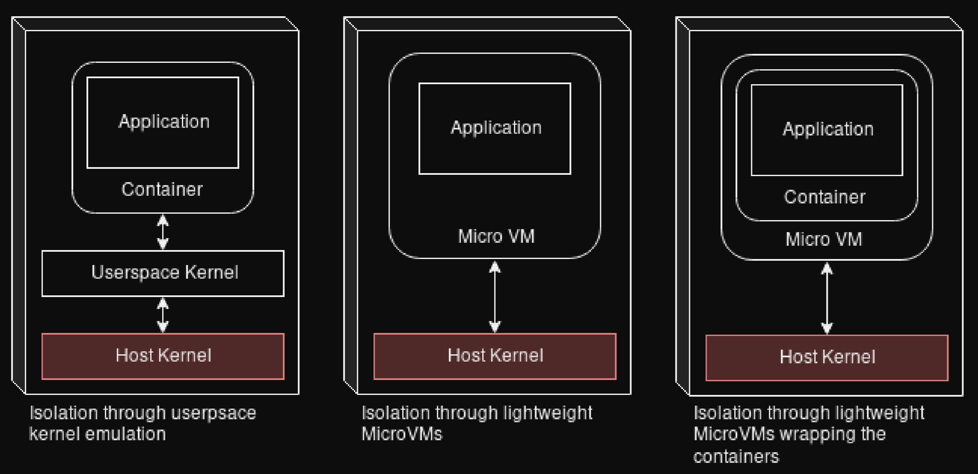
Micro Vms
Virtualization Intro (Theory)

Slide 17
CONTAINERS CONTEXT
Cgroups – Control Groups
Linux kernel feature that limits, accounts for, and isolates the resource usage (CPU, memory, disk I/O, network, etc.) of a collection of processes.
$ sudo cgset -r cpu.cfs_period_us=1000000 cpulimit
$ sudo cgexec -g cpu:cpulimit myproc
$ cat /proc/${pidof myproc}/cgroup
Linux Namespaces
Linux kernel feature that partitions kernel resources such that each set of processes sees a different set of resources.
$ sudo unshare --pid --net --ipc --uts --mount –fork
Chroot
Changes the apparent root directory for the current running process and their children which cannot access outside resources. This modified environment is called a chroot jail.
$ chroot ~/myroot
Seccomp
Filter mode which allows to write BPF programs that determine whether a given system call will be allowed or not
prctl (PR_SET_SECCOMP, SECCOMP_MODE_STRICT);
Virtualization Intro (Theory)

Slide 18
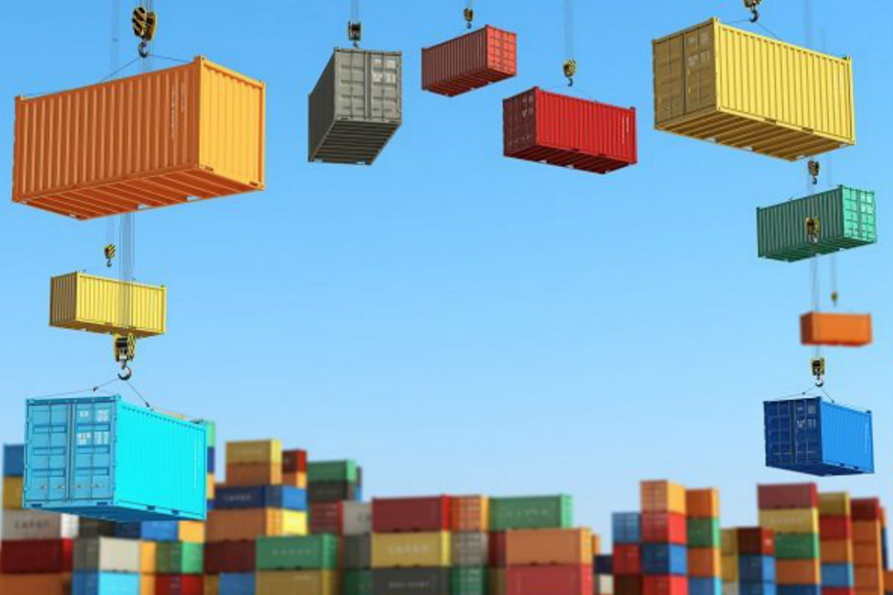
CONTAINERS CONTEXT
Standardization
OCI:
Open Container initiative (runc)
CRI:
Container Runtime Interface (containerd, CRI-O)
CRI-O:
OCI-Based implementation of CRI for k8s
Virtualization Intro (Theory)

Slide 19
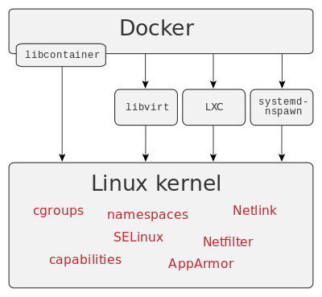
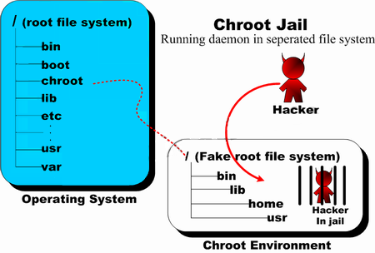
Containers Context
Virtualization Intro (Theory)

Slide 20
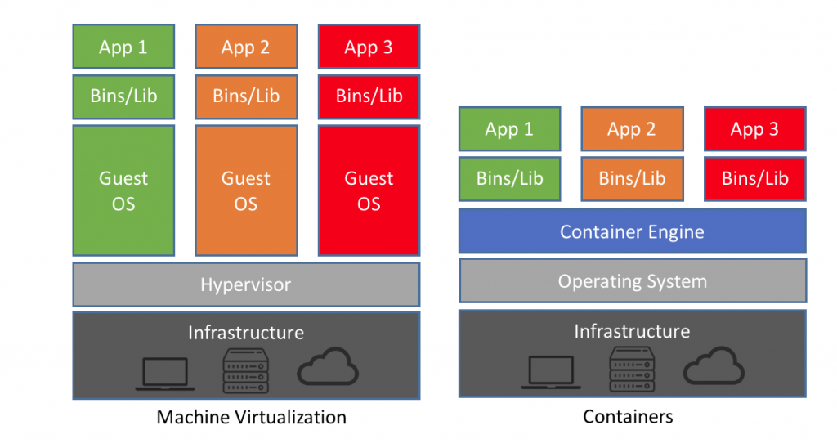
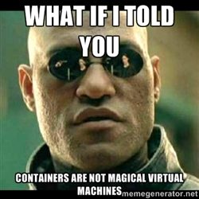
Containers Context
Virtualization Intro (Theory)

Slide 21
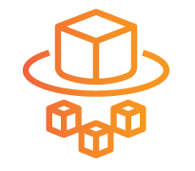





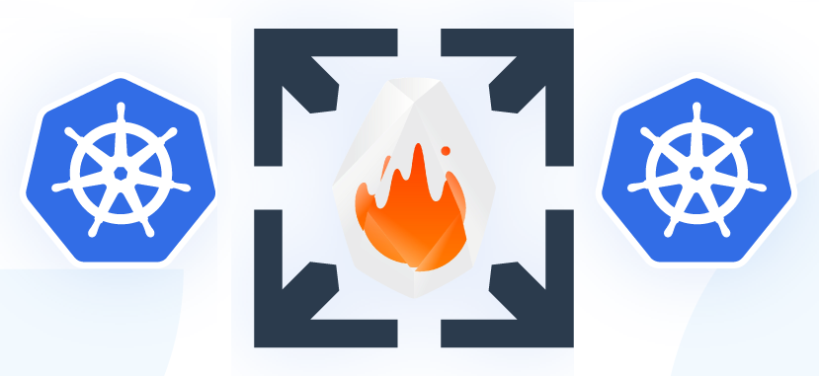
MicroVM Use cases
AWS Fargate
AWS Lambda
Kata Containers
Open
Nebula
Weave
ignite
Weave Firekube
Virtualization Intro (Theory)

Slide 22
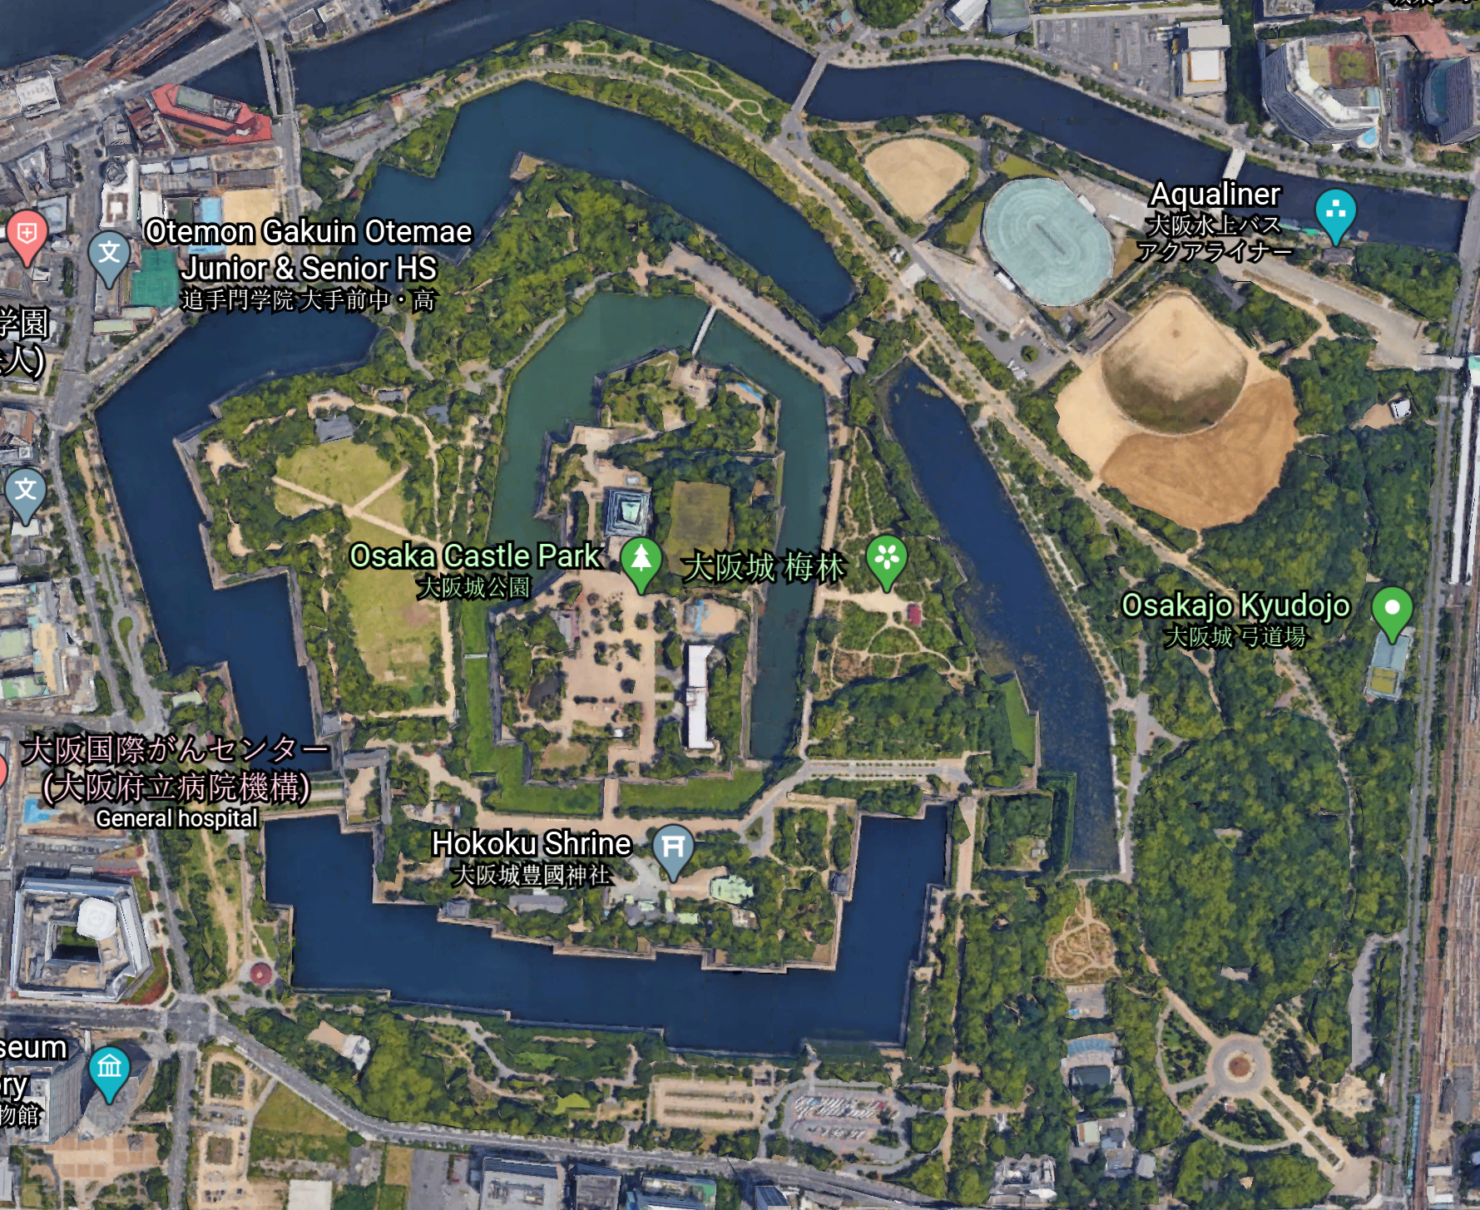
Security boundaries
HW
Memory
Instructions
VMM
Memory
Kernel
OS
Chroot
Namespaces
Cgroups
Virtualization Intro (Theory)

Slide 23
Part I Hands on

Slide 24

LABS
Duration: 17.5min
Simple user-space VMs (2.5min)
Simple raw container (5min)
Simple docker (2.5min)
Simple firecracker (2.5min)
MicroVM vs Container (5min)
First step with python VM (Practice)

Slide 25
Simple user-space VMs
Duration: 2.5min
General explanation:
2 Simple VMs: Python and C
(Stack Based, Instruction Symbol to Instruction Callback mapping)
Exercise:
Add 2 numbers
Print “VM” (pyVM)
Emulate multiplication with add and loop
Add CPUID instruction (cVM)
First step with python VM (Practice)

Slide 26
Simple raw container
Duration: 5min
General explanation:
Create simple raw container
Follow steps in README.tx
Exercise:
Download lastest ubuntu rootfs image
Create dir to contain our future container
Extract ubuntu rootfs to our future container
Mount proc fs for our future container
Mount /dev/pts for out future container (to allow tty attachment)
Create chroot jail, thus entering our future-present container
Compare container vs host
First step with python VM (Practice)

Slide 27
Simple docker
Duration: 2.5min
General explanation:
Create simple docker container
Follow steps in README.txt
Exercise:
install docker
run simple hello-world image for sanity test
run docker with minimal bash image
Compare container vs host
First step with python VM (Practice)

Slide 28
Simple Firecracker
Duration: 2.5min
General Explanation:
Create simple firecracker vm
Follow steps in README.txt
Exercise:
Check for HW virtualization requirements
Download latest firecracker
Start firecracker with open socket
Login to firecracker
Compare vm vs host
First step with python VM (Practice)

Slide 29
MicroVms vs containers
Duration: 5min
General Explanation:
Create simple firecracker vm
Follow steps in README.txt
Exercise:
Try to find differences between docker and firecracker
First step with python VM (Practice)

Slide 30

Sec & Tech Recap
Duration: 2.5min
Virtualization has been around since the 60s
Virtualization enables layered defense (HW, VMM, OS)
HW Assisted virtualization is the most efficient
VMs are more isolated then Containers
MicroVMs offer VM’s security and Container’s agility
First step with python VM (Practice)

Slide 31
part I: The end Thank you for listening !

Slide 32
Break – 10mins

Slide 33
Part ii KVM Micro vms

Slide 34
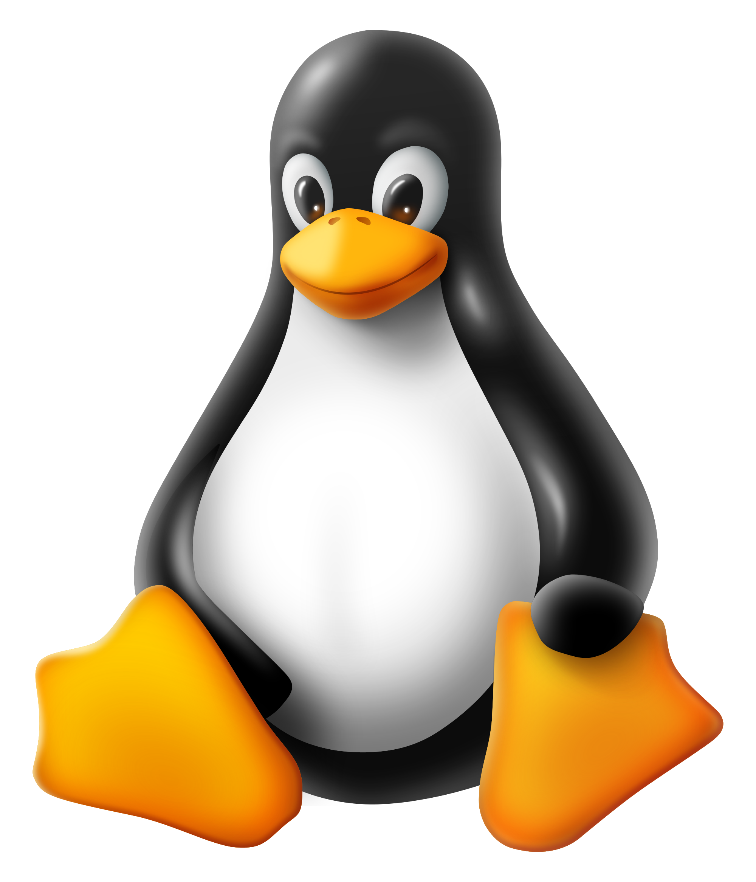
Topics
HW: VTX/VMX
Kernel vs User Space
Intro to KVM
KVM vs Container
Firecracker Intro
Virtualization Intro (Theory)

Slide 35
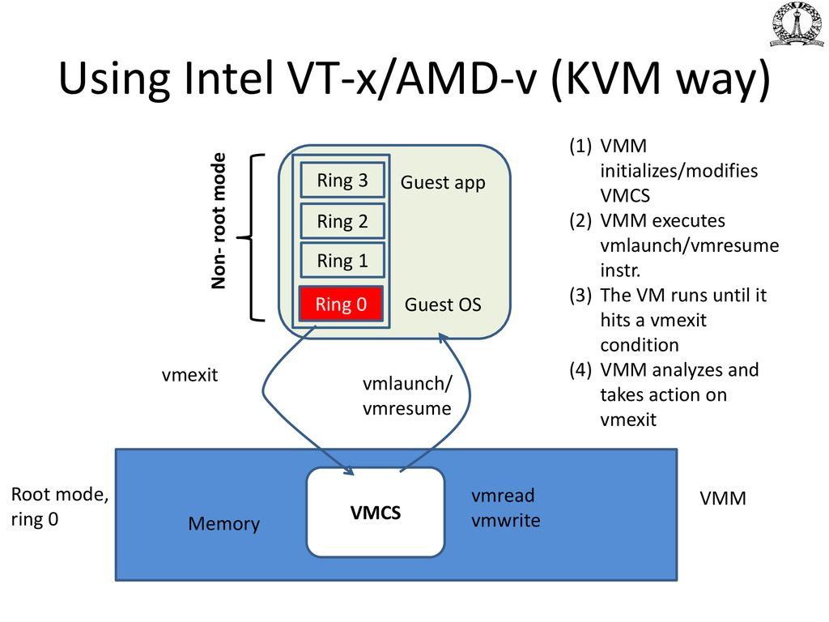
HW: VTX/AMD-V
Hardware Assisted Virtualization VT-x \ AMD-V
Hardware support for vCPU, vMMU and more…
All code runs on actual hardware (no emulation overhead)
Traps and context switches managed by hardware
VMCS - Virtual Machine Control Structure
4KiB physical memory of process information
VM exit reasons as well as VM specific (context)
Adds 2 CPU privilege modes:
Root and Non-Root
VMM as Root and Guest as Non-Root
Adds multiple special instruction
Control transitions between VMM and Guest
Manage Guest state
Example: VMPTRLD, VMPTRST, VMCLEAR, VMREAD, VMWRITE, VMCALL, VMLAUNCH, VMRESUME, VMXOFF, and VMXON
Virtualization Intro (Theory)

Slide 36
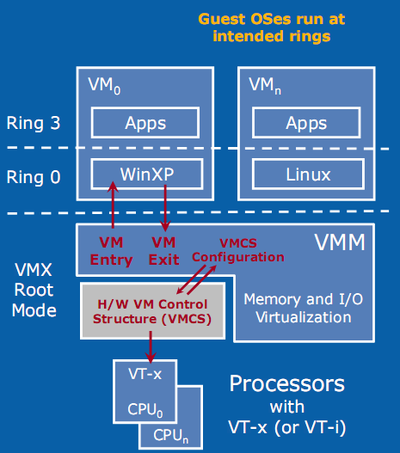
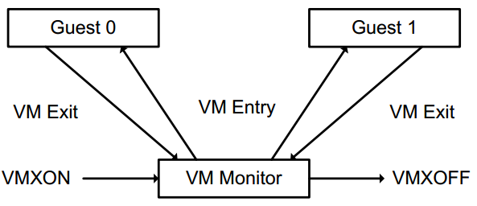
HW: VTX/VMX
Virtualization Intro (Theory)

Slide 37
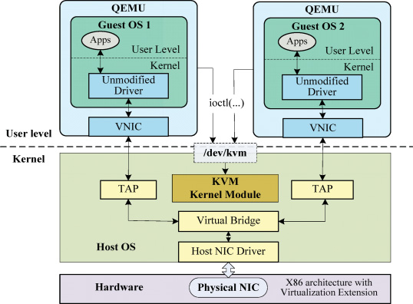
User Space
Virtualization Intro (Theory)

Slide 38
Kernel Space
Virtualization Intro (Theory)

Slide 39
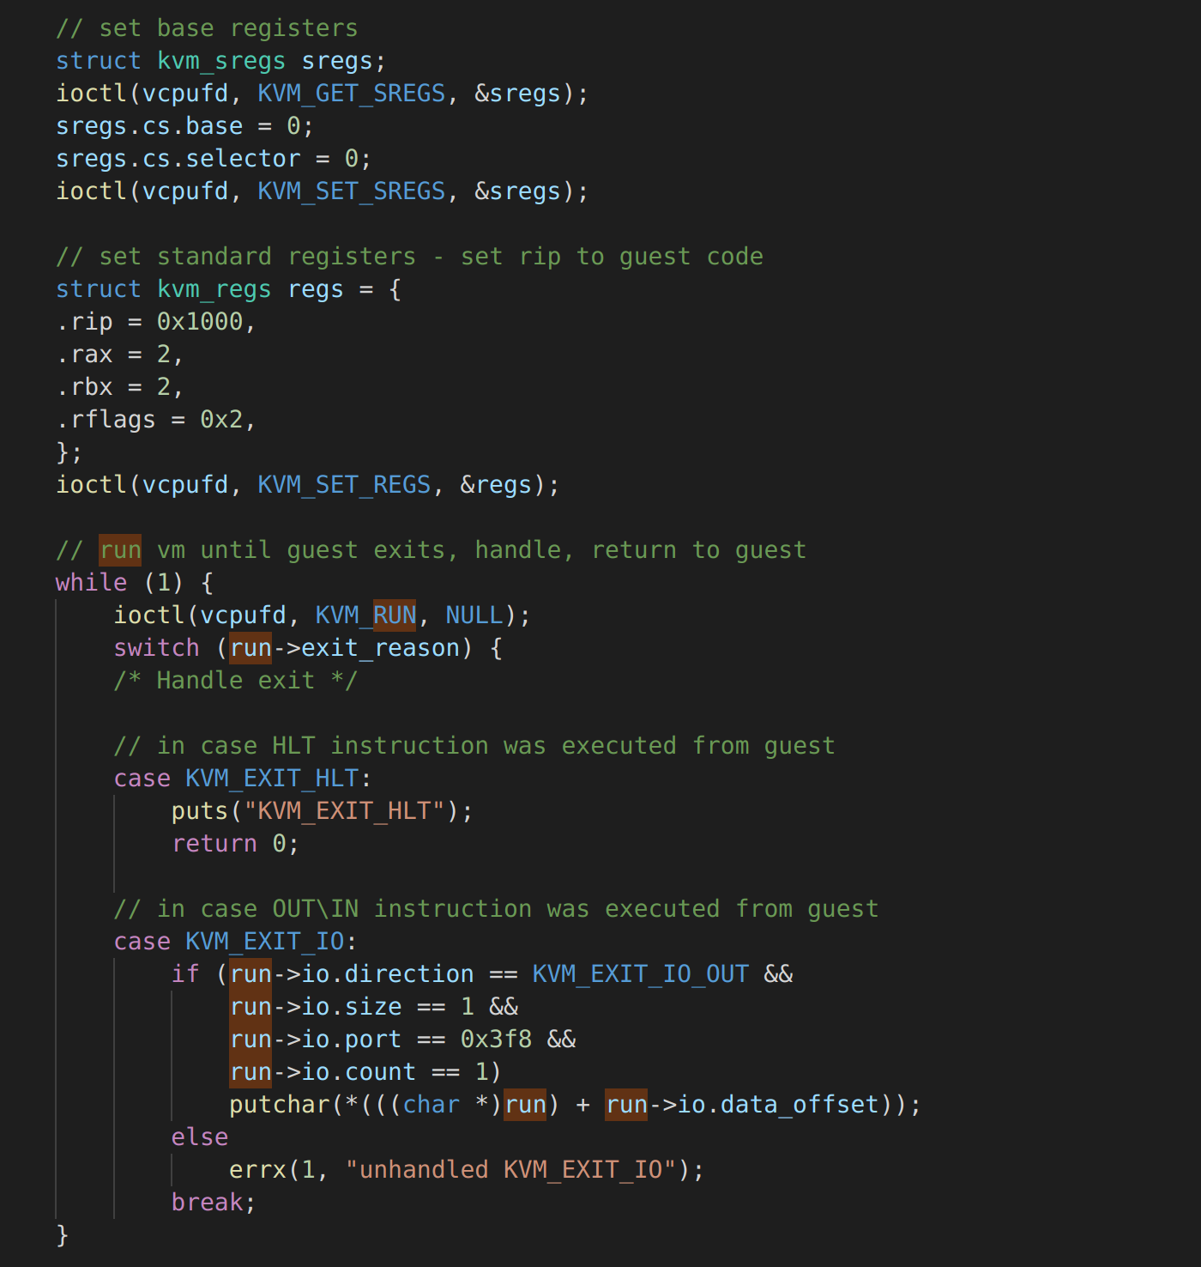
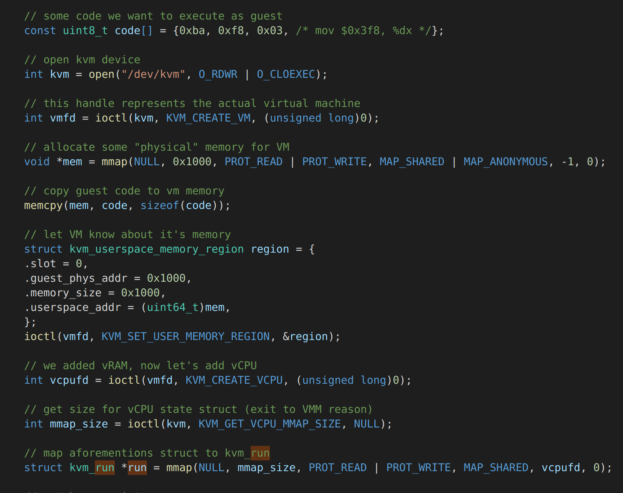
User Space
Virtualization Intro (Theory)

Slide 40
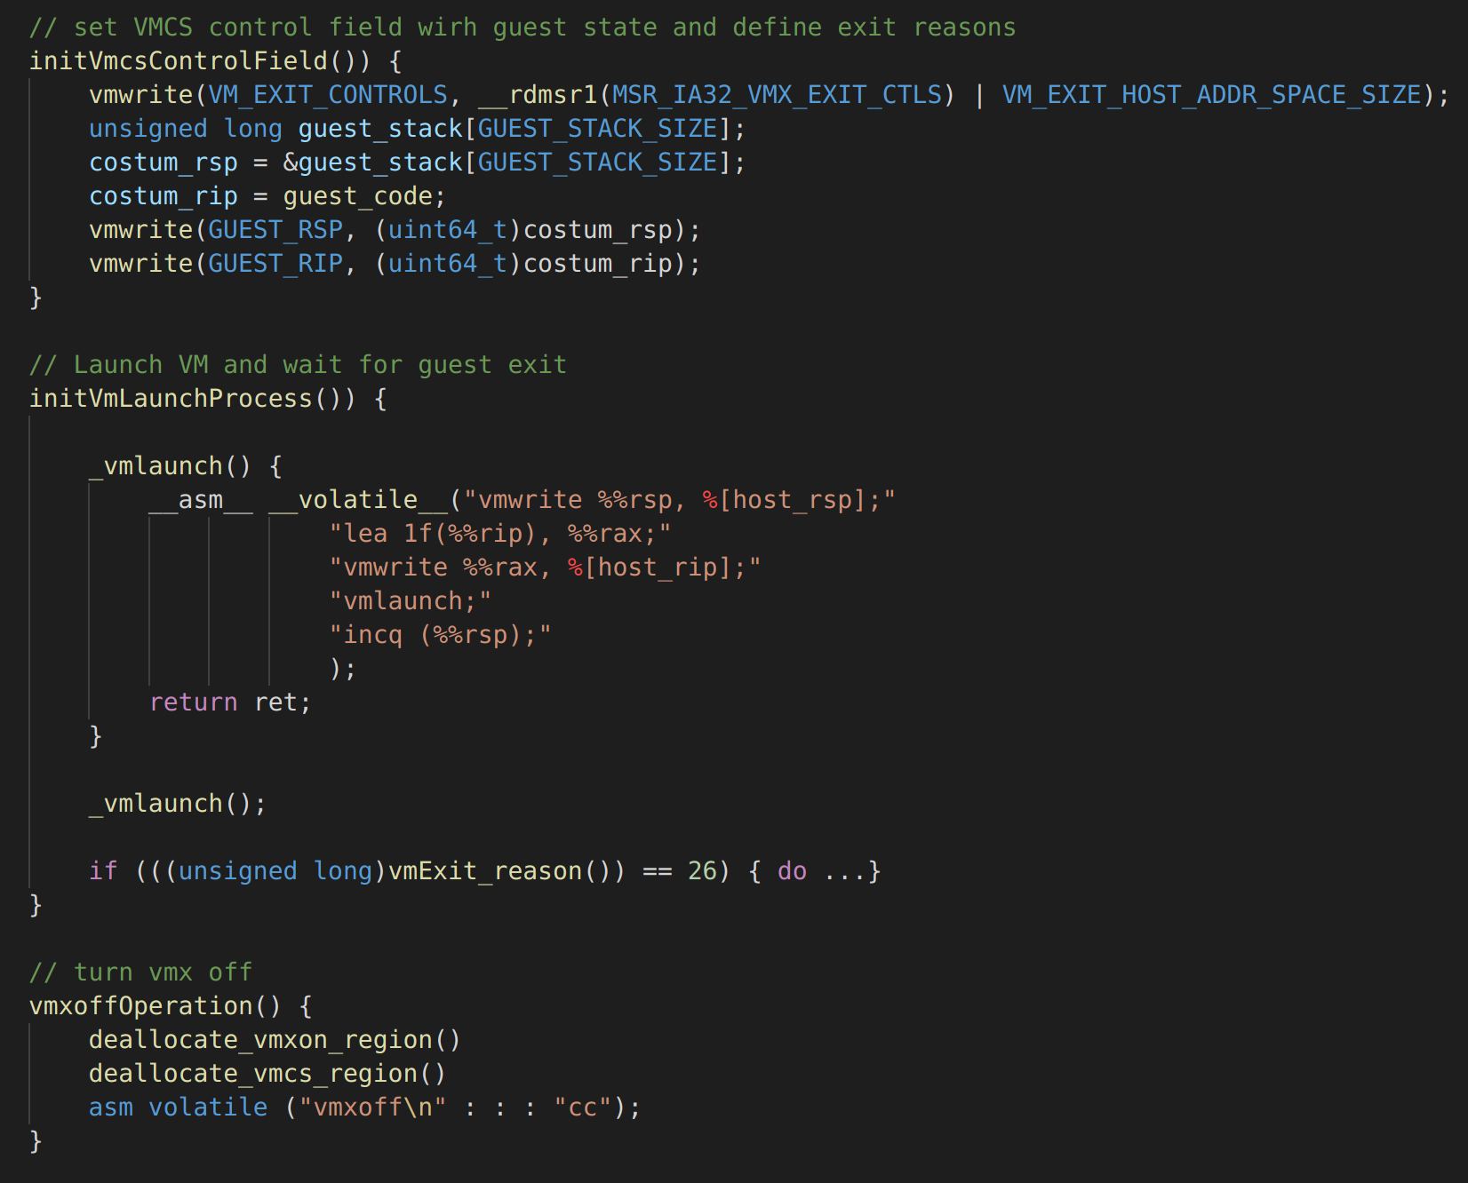
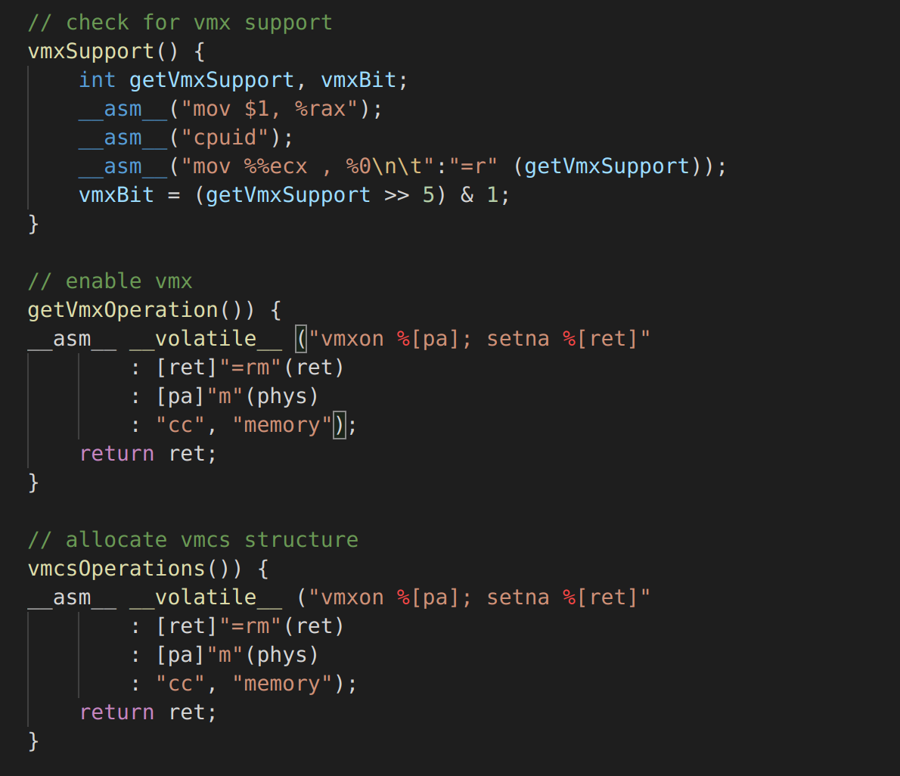
Kernel Space
Virtualization Intro (Theory)

Slide 41
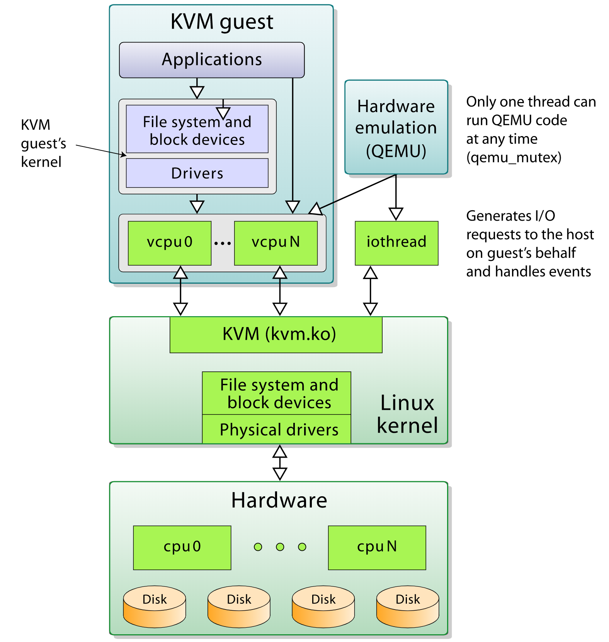
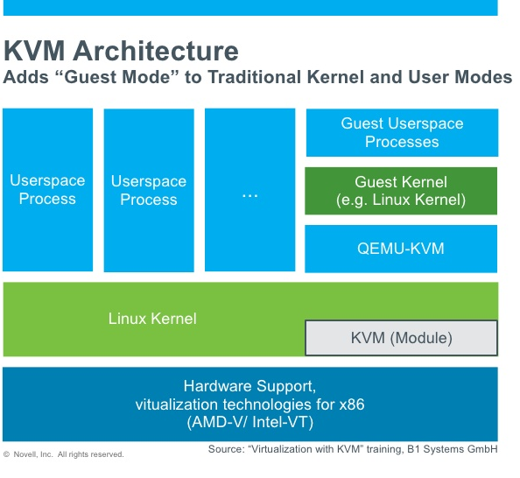
Intro to KVM
Virtualization Intro (Theory)

Slide 42
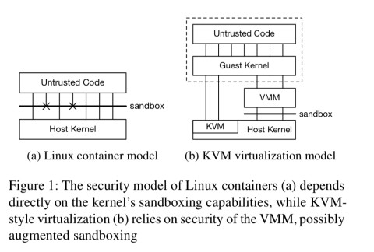
KVM vs Container
Virtualization Intro (Theory)

Slide 43
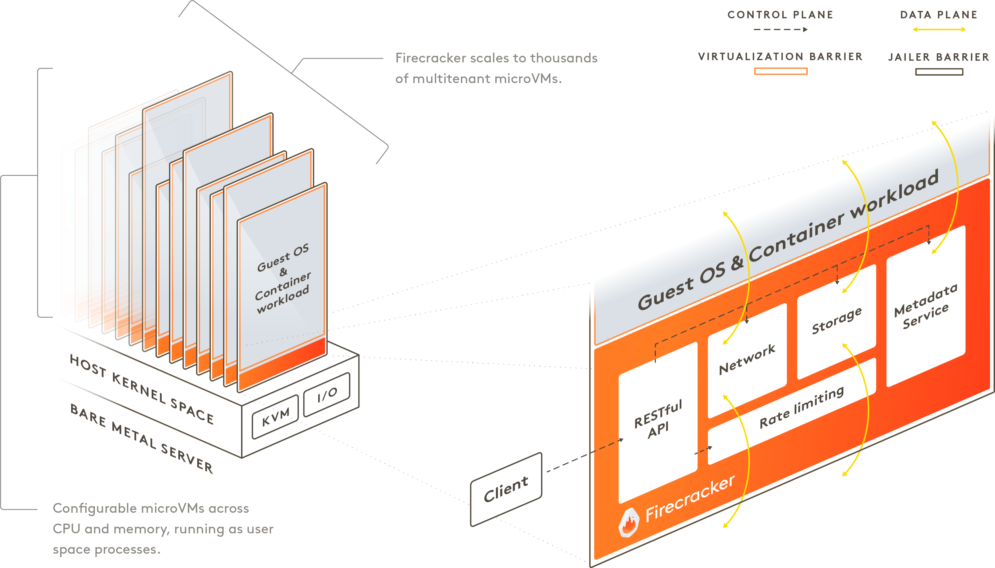
Firecracker Basic intro
Virtualization Intro (Theory)

Slide 44
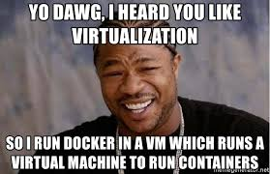
Security boundaries
HW:
Special Root mode for VMM
Control sensitive instructions
Kernel:
Host kernel implements VMM functionality
Reduce syscalls attack surface with seccomp
Guest VM has and independent kernel
OS:
Host can wrap VM process with a container
Guest can wrap workload with a container
Virtualization Intro (Theory)

Slide 45
Part II Hands on

Slide 46

LABS
Duration: 37.5min
Execute simple user-space vm (10min)
Execute simple kernel-space vm (10min)
Examine vulnerabilities (10min)
Firecracker teaser (7.5min)
First step with python VM (Practice)

Slide 47
EXECute Simple user-space VM
Duration: 10min
General Explanation:
Build & Play with VMs
Follow steps in README.txt
Exercise:
Examine code
Change printed value
Print “Goodbye World”
Print out with 2 increments without changing test.S
First step with python VM (Practice)

Slide 48
Execute simple kernel-space vm
Duration: 10min
General Explanation:
Build & Play with Kernel Part VMM
Follow steps in README.txt
Exercise:
Examine code
Try to crash host
First step with python VM (Practice)

Slide 49

Examine Vulnerabilities
Duration: 10min
CVE-2019-3016: KVM PV TLB vulnerability: guest user can read memory from host and other guests: RCE, PE
https://nvd.nist.gov/vuln/detail/CVE-2019-3016
https://packetstormsecurity.com/files/157233/Kernel-Live-Patch-Security-Notice-LSN-0065-1.html
CVE-2018-12904: KVM nested virtualization vulnerability: L2 HV can execute VMX instructions: RCE, PE
https://www.exploit-db.com/exploits/44944
https://wiki.xenproject.org/wiki/Nested_Virtualization_in_Xen
CVE-2019-6974: Use after free in kvm_ioctl_create_device(): crash guest: DDoS, PE
https://nvd.nist.gov/vuln/detail/CVE-2019-6974
https://www.exploit-db.com/exploits/46388
CVE-2019-18960: vsock bufferoverflow: guest can r/w to a segment of the host-side Firecracker process: RCE, PE
https://cve.mitre.org/cgi-bin/cvename.cgi?name=CVE-2019-18960
https://www.tenable.com/cve/CVE-2019-18960
CVE-2020-2732: KVM nested virtualization vulnerability: L2 can trick L0 to accessing sensitive L1 resources: RCE, PE
https://cve.mitre.org/cgi-bin/cvename.cgi?name=CVE-2020-2732
https://wiki.xenproject.org/wiki/Nested_Virtualization_in_Xen
CVE-2019-19332: out-of-bounds mem write in 'KVM_GET_EMULATED_CPUID' ioctl(2): /dev/kvm access: DDoS.
https://cve.mitre.org/cgi-bin/cvename.cgi?name=CVE-2019-19332
https://git.kernel.org/pub/scm/linux/kernel/git/torvalds/linux.git/commit/?id=433f4ba1904100da65a311033f17a9bf586b287e
CVE-2019-7222: KVM kvm_inject_page_fault Uninitialized Memory Leak
https://nvd.nist.gov/vuln/detail/CVE-2019-7222
https://bugs.chromium.org/p/project-zero/issues/detail?id=1759
First step with python VM (Practice)

Slide 50
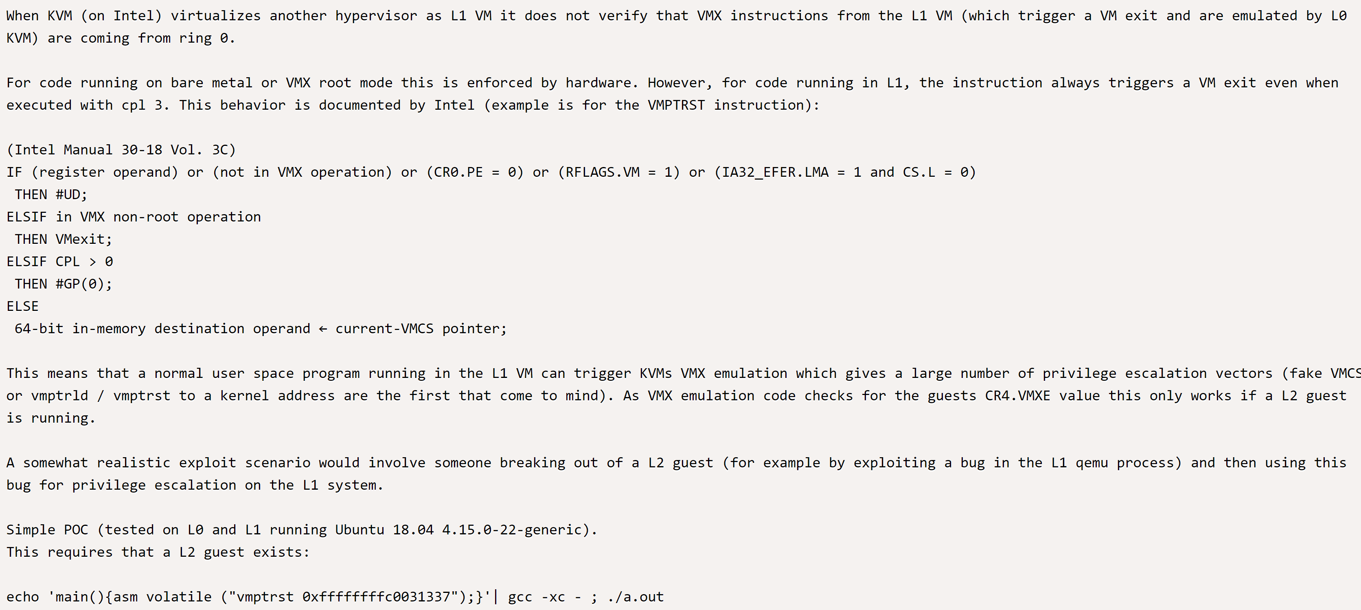
Examine Vulnerabilities
CVE-2018-12904: KVM nested virtualization vulnerability: L2 HV can execute VMX instructions: RCE, PE
First step with python VM (Practice)

Slide 51
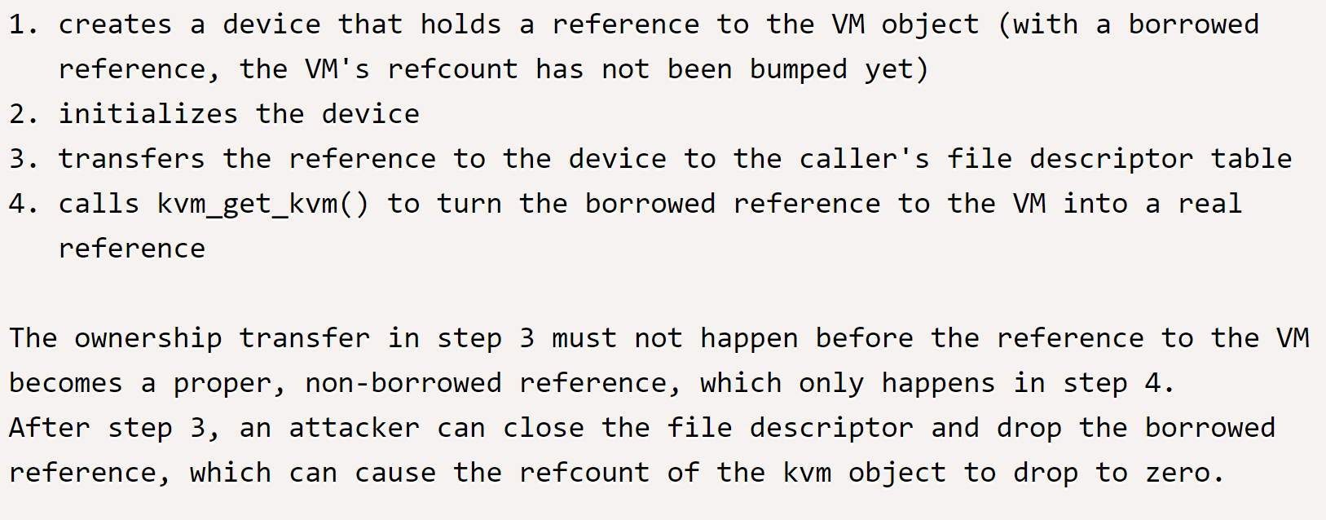
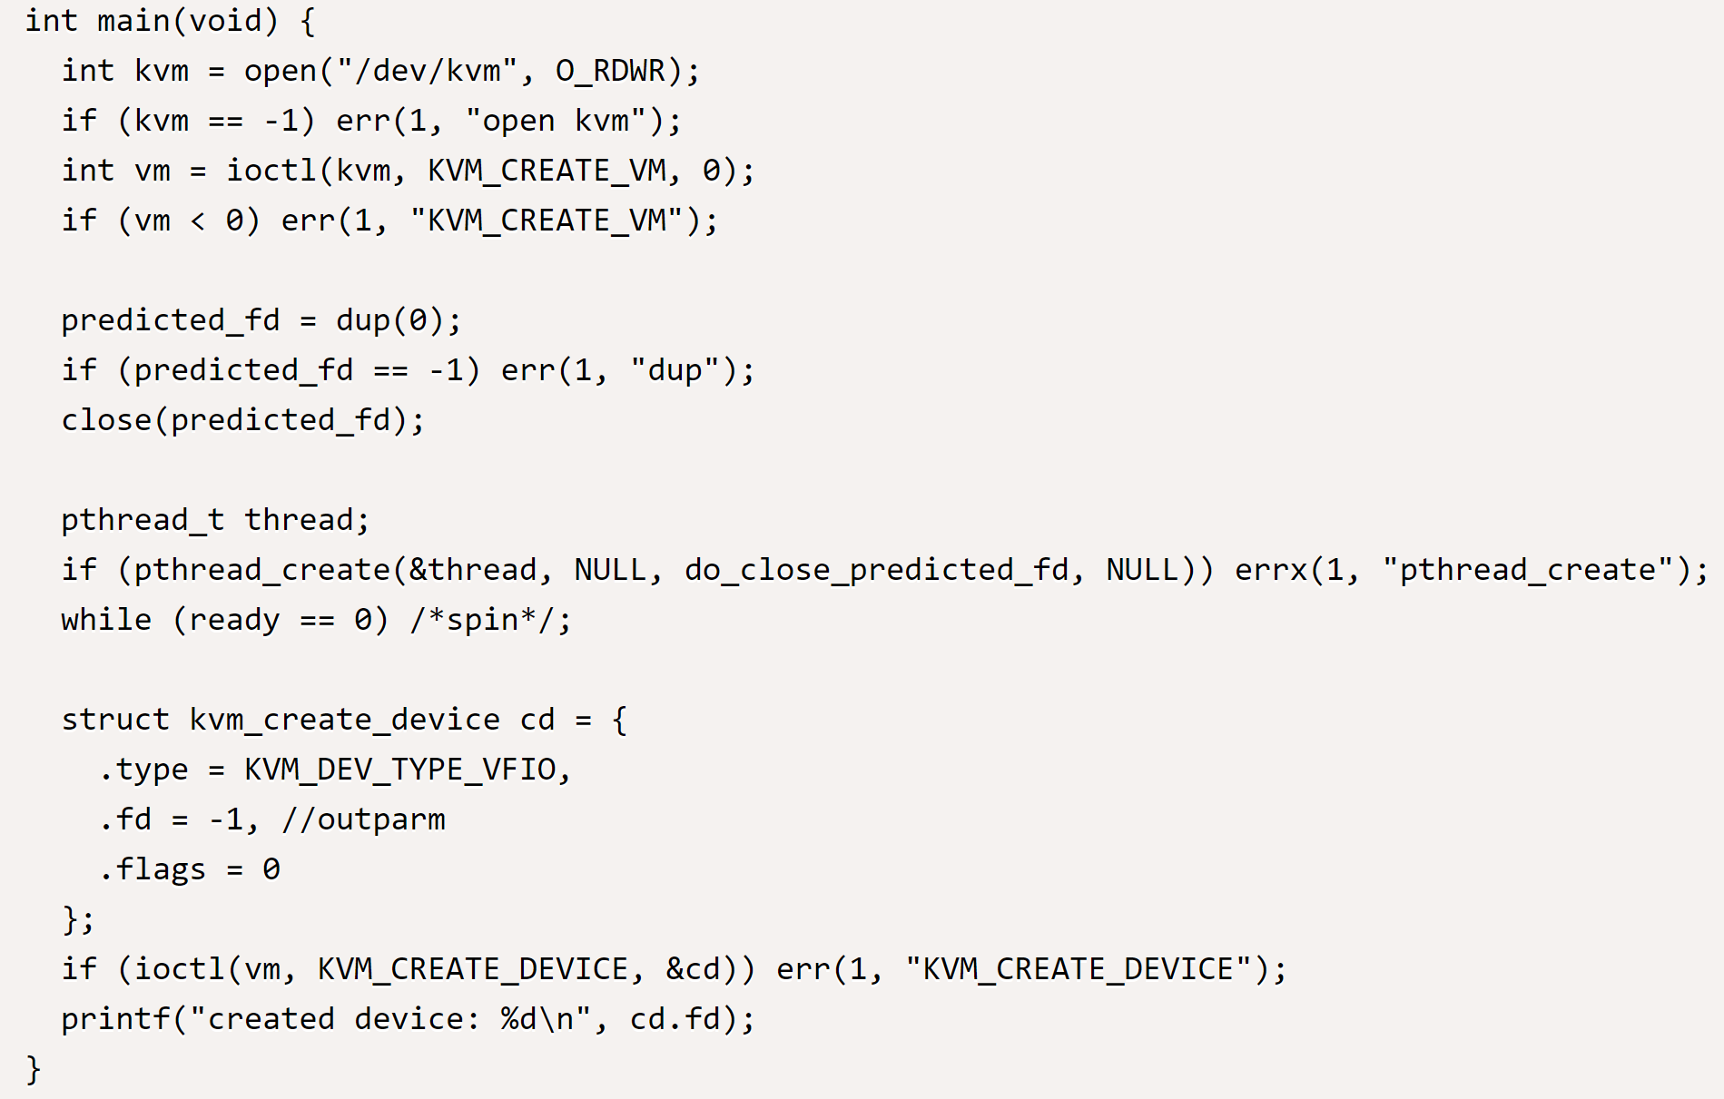
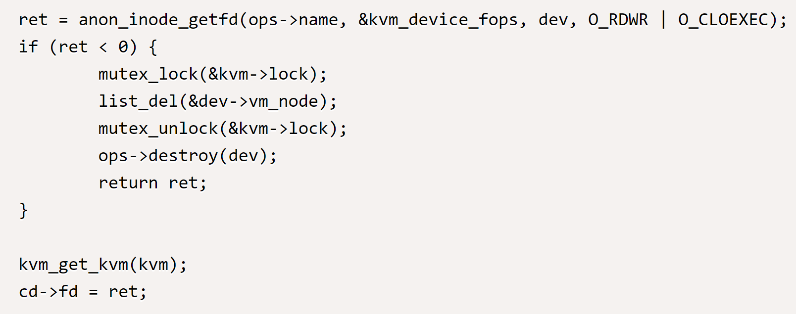
Examine Vulnerabilities
CVE-2019-6974: Use after free in kvm_ioctl_create_device(): crash guest: DDoS, PE
First step with python VM (Practice)

Slide 52
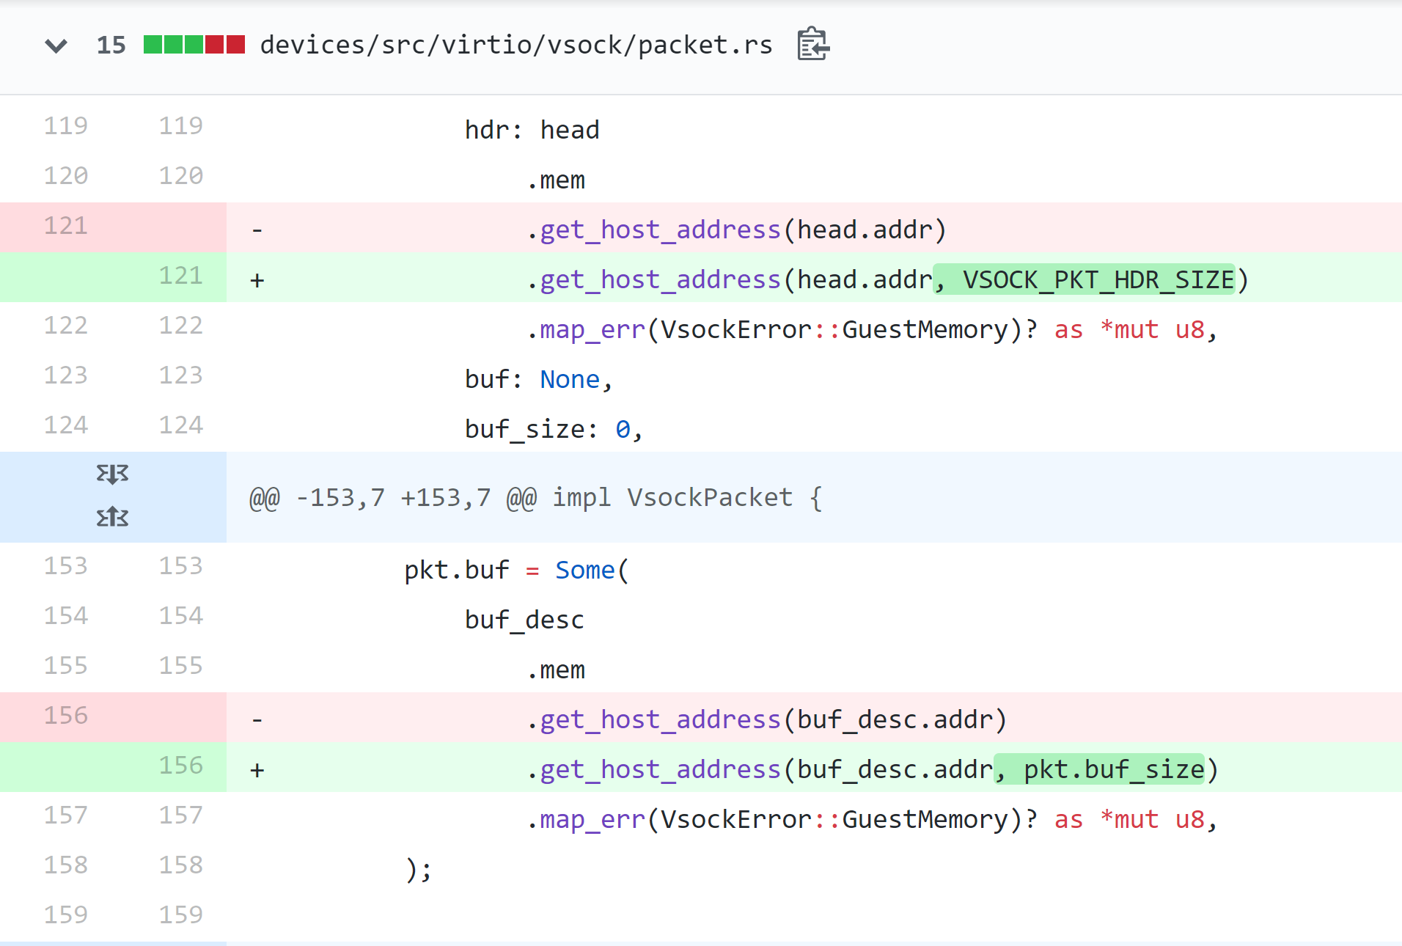
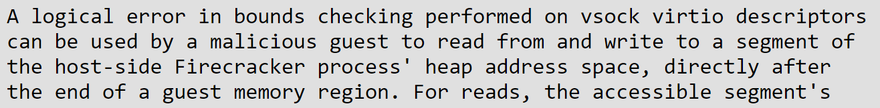
Examine Vulnerabilities
CVE-2019-18960: vsock bufferoverflow: guest can r/w to a segment of the host-side Firecracker process: RCE, PE
First step with python VM (Practice)

Slide 53
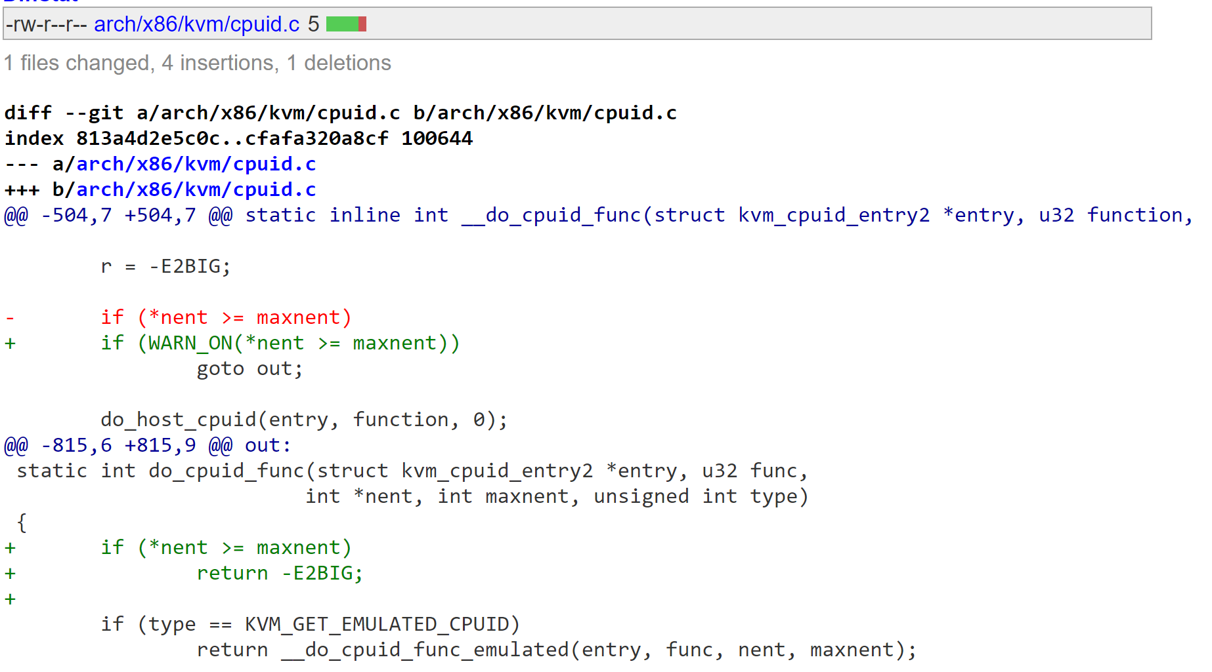
Examine Vulnerabilities
CVE-2019-19332: out-of-bounds mem write in 'KVM_GET_EMULATED_CPUID' ioctl(2): /dev/kvm access: DDoS.
First step with python VM (Practice)

Slide 54
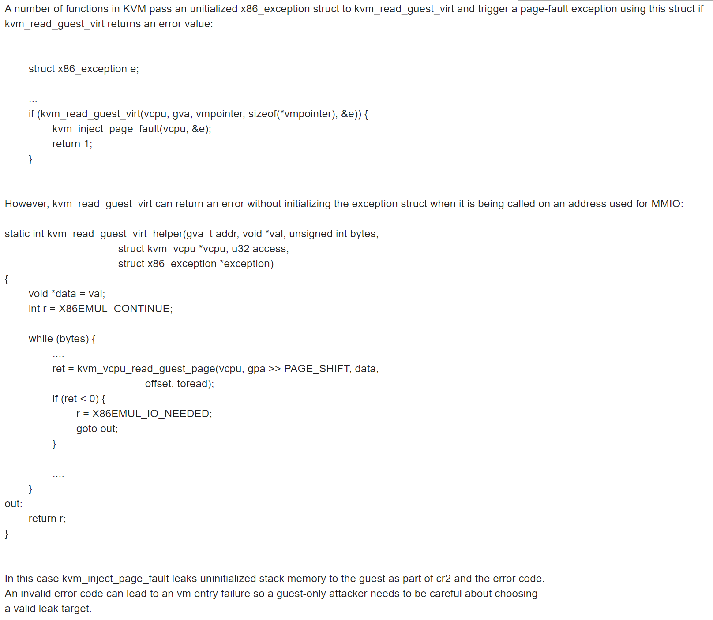
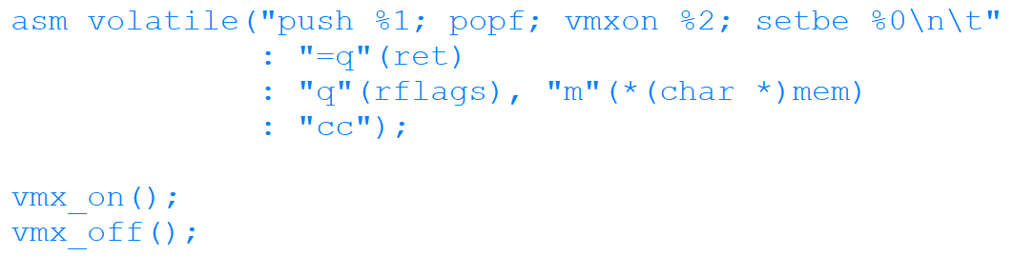
Examine Vulnerabilities
CVE-2019-7222: KVM kvm_inject_page_fault Uninitialized Memory Leak
First step with python VM (Practice)

Slide 55
Sec & Tech Recap
Duration: 2.5min
HW Assisted Virtualization is the basis for KVM
KVM is made of Kernel Part and User Part
kvm.ko expose ioctl() interface via /dev/kvm
Crash in Guest Kernel – Doesn’t affect host Kernel
Crash in VMM’s Kernel Part – Affects host kernel
First step with python VM (Practice)

Slide 56

Attack vectors
Intel instruction set in virtualized env (i.e. sandsifter)
Firecracker virtio \ vsock (device model \ protocol) fuzzing
Client API
Jail misconfiguration
Outside world communication
First step with python VM (Practice)

Slide 57

Ideas
HW Virtualization and KVM as Debug\Fuzz\Monitor platform
Examine MicroVM for malware concealment
Seamlessly wrap app (HW container)
./metalcage kernel_exploit.bin # no impact on host kernel
./docker kernel_exploit.bin # impact on host
Secure outside world communication
First step with python VM (Practice)

Slide 58

Top 10 buzzwords
Full Virtualization – Guest OS is unaware
HW Virtualization – emulated code runs natively
Para virtualization – HyperCalls mostly used for IO emulation
VT-x \ AMD-V – HW Virtualization techs
MicroVM – Efficient VM with sterilized attack surface
Nested Virtualization – Running HV on top of existing HV
Jail – Essentially a container
Firecracker \ QEMU – User space VMM
GitOps – Git oriented DevOps
App Virtualization – App is somewhere else, all you’re getting is pixels
First step with python VM (Practice)

Slide 59
part I: The end Thank you for listening !

Slide 60
part II: The end Thank you for listening !

Slide 61
Break – 20mins

Slide 62
Part iIi Firecracker

Slide 63

Topics
Firecracker
Jailer
Unix Socket REST API
Peripherals: Kernel, Filesystem, Networking, etc.
Virtualization Intro (Theory)

Slide 64
Firecracker Basic intro
Virtualization Intro (Theory)

Slide 65
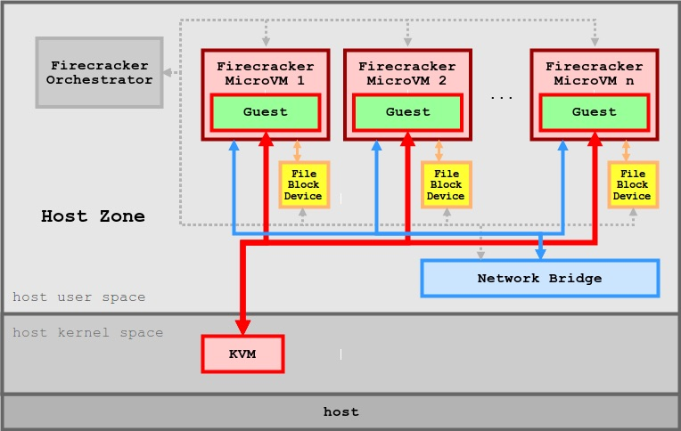
Firecracker Basic intro
Virtualization Intro (Theory)

Slide 66

Jailer
Close all open file descriptors
Create chroot directory
Copy exec-file (firecracker) to chroot directory
Create v1 cgroups: cpu, cpuset, pids
Assign NUMA node
Unshare namespace with unshare()
Expose /dev/kvm and /dev/tun using mknod
Join network namespace
Execute exec-file
Virtualization Intro (Theory)
Notes:
Put logo inside jail

Slide 67
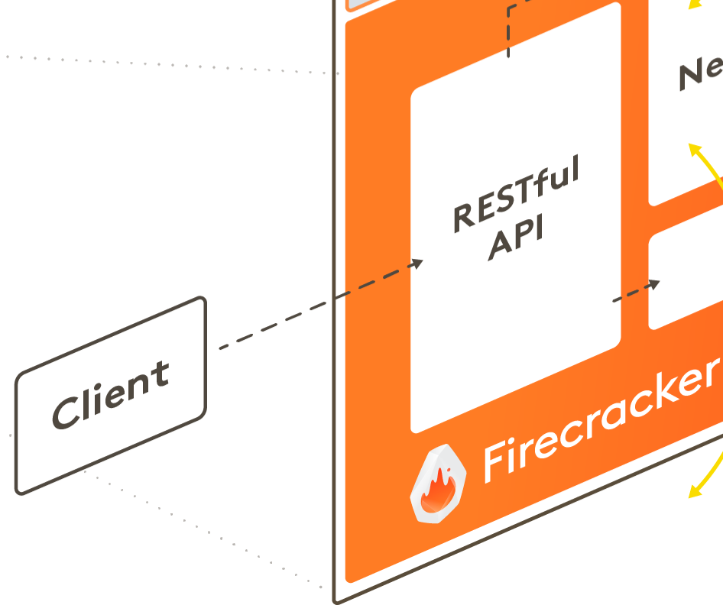
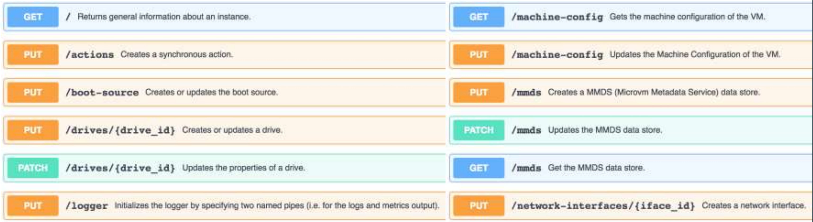
Unix Socket REST API
Virtualization Intro (Theory)

Slide 68
Unix Socket REST API
Firecracker can expose REST API Sever with optional config-file
./firecracker --api-sock /tmp/firecracker.socket [--config-file]
Set kernel for firecracker VM:
curl --unix-socket /tmp/firecracker.socket -i \
-X PUT 'http://localhost/boot-source' \
-H 'Accept: application/json' \
-H 'Content-Type: application/json' \
-d "{
\"kernel_image_path\": \"${kernel_path}\",
\"boot_args\": \"console=ttyS0 reboot=k panic=1 pci=off\"
}“
Set VM config:
curl --unix-socket /tmp/firecracker.socket -i \
-X PUT 'http://localhost/machine-config' \
-H 'Accept: application/json' \
-H 'Content-Type: application/json' \
-d '{
"vcpu_count": 2,
"mem_size_mib": 1024,
"ht_enabled": false
}'
Start firecracker VM:
curl --unix-socket /tmp/firecracker.socket -i \
-X PUT 'http://localhost/actions' \
-H 'Accept: application/json' \
-H 'Content-Type: application/json' \
-d '{
"action_type": "InstanceStart"
}‘
Send Ctrl+Alt+Delete to shutdown VM:
curl --unix-socket /tmp/firecracker.socket -i \
-X PUT "http://localhost/actions" \
-H "accept: application/json" \
-H "Content-Type: application/json" \
-d "{
\"action_type\": \"SendCtrlAltDel\"
}"
Virtualization Intro (Theory)

Slide 69
Unix Socket REST API
Firecracker REST API Sever config-file
{
"boot-source": {
"kernel_image_path": "vmlinux.bin",
"boot_args": "console=ttyS0 reboot=k panic=1 pci=off"
},
"drives": [
{
"drive_id": "rootfs",
"path_on_host": "xenial.rootfs.ext4",
"is_root_device": true,
"is_read_only": false
}
],
"machine-config": {
"vcpu_count": 2,
"mem_size_mib": 1024,
"ht_enabled": false
}
}
Virtualization Intro (Theory)

Slide 70

Peripherals
Drives
Network device
Vsock
Virtio
MMDS
Virtualization Intro (Theory)
Notes:
Add chart showing images of peripherals connected to firecracker’s logo

Slide 71

Security boundaries
Host OS-Level Isolation (Jailer)
Guest Independent Kernel
Host – Guest Communication (MMDS)
Device Model (vsock \ virtio)
Exposed endpoint via Drive \ Network
Virtualization Intro (Theory)
Notes:
Explain moat defense

Slide 72
Part III Hands on

Slide 73
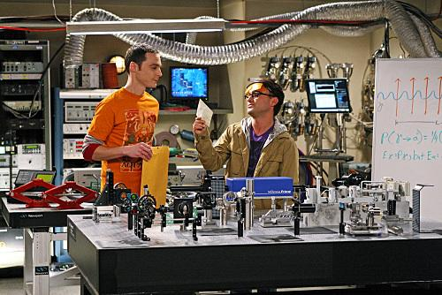
LABS
Duration: 17.5min
Run with Network (5min)
Run with Jailer (5min)
Execute parallel workloads (7.5min)
First step with python VM (Practice)

Slide 74
Run with Network
Duration: 5min
General Explanation:
Get all required files
Follow steps in README.txt
Exercise:
Execute ./get_latest.sh
Execute ./run_microvm.sh
Add Network device
First step with python VM (Practice)

Slide 75
Run with Jailer
Duration: 5min
General Explanation:
Get all required files
Follow steps in README.txt
Exercise:
Execute ./get_latest.sh
Execute ./prisoner.sh
Execute ./start.sh
Examine code and created env
First step with python VM (Practice)

Slide 76
Execute parallel workloads
Duration: 7.5min
General Explanation:
Follow steps in README.txt
Exercise:
Setup
Start 100 machines (and then increase)
Make some machine work the hardest
View boot time graph
First step with python VM (Practice)

Slide 77
Sec & Tech Recap
Duration: 2.5min
Firecracker and KVM provide HW and Kernel isolation
Jailer is an extra defense, sort of container for firecracker
Firecracker MicroVMs are very efficient, can boot in 125ms
Adding network is similar to container
First step with python VM (Practice)

Slide 78
part III: The end Thank you for listening !

Slide 79
Break – 10mins

Slide 80
Part iV Devops use cases

Slide 81
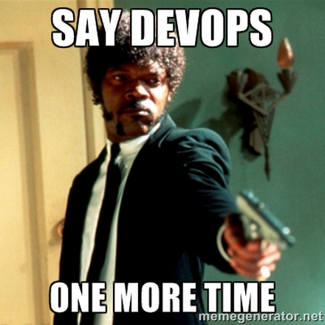
Topics
Solutions Classification
MicroVMs Based Solutions
Virtualization Intro (Theory)

Slide 82
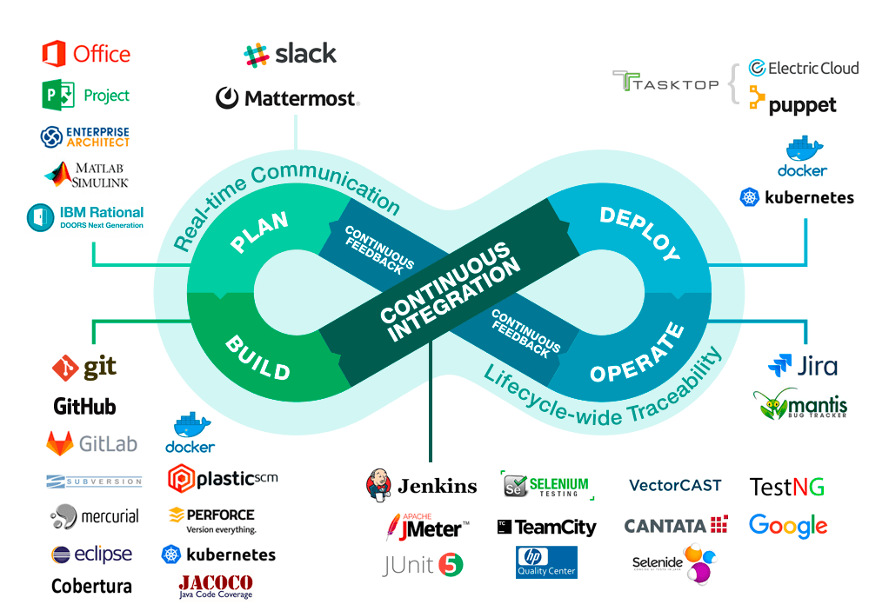

Solutions Classification
Virtualization Intro (Theory)

Slide 83
MicroVMs Based Solutions
AWS Fargate
AWS Lambda
Kata Containers
Open
Nebula
Weave
ignite
Weave Firekube
Virtualization Intro (Theory)

Slide 84
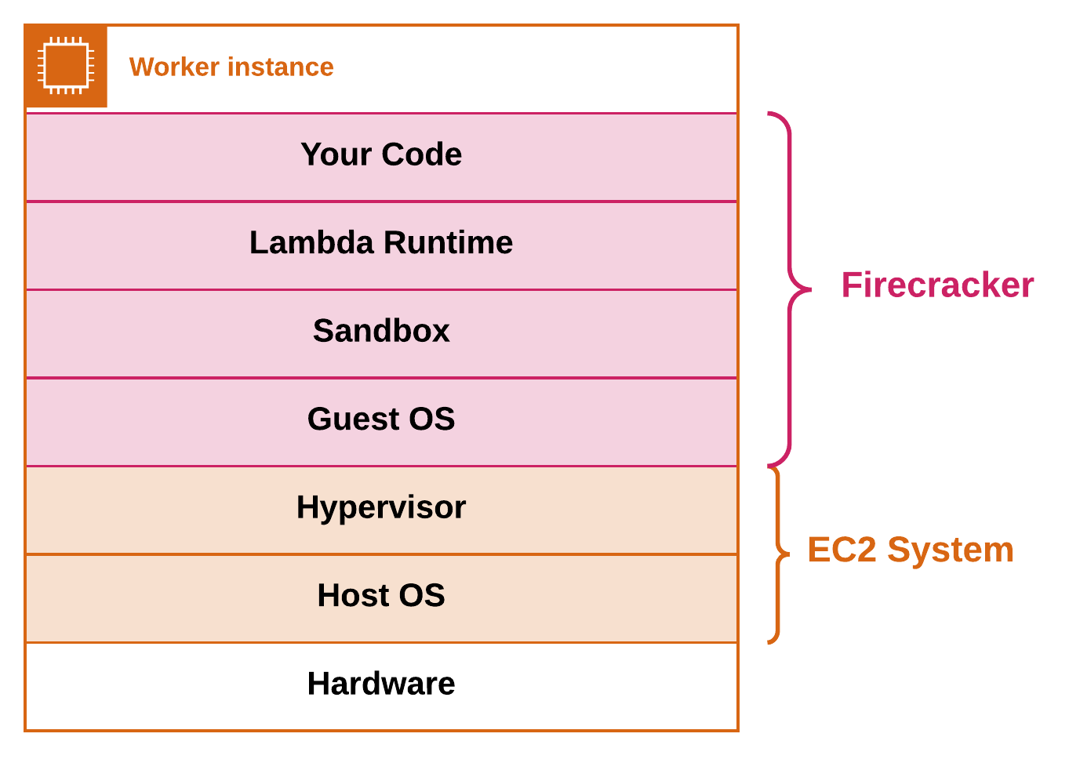
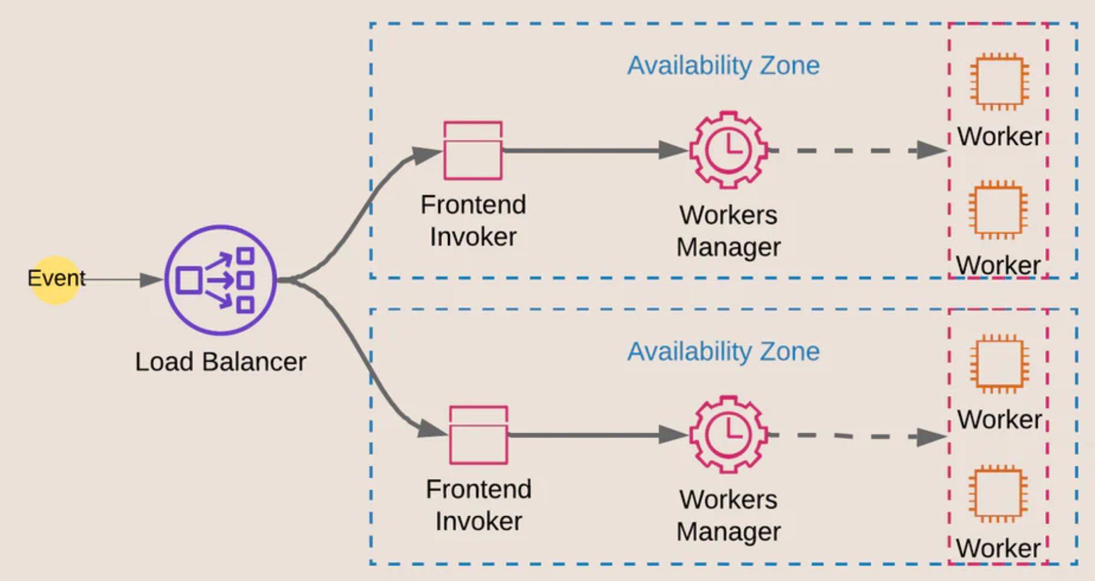
AWS Lambda
Virtualization Intro (Theory)
Notes:
Moat Defense

Slide 85
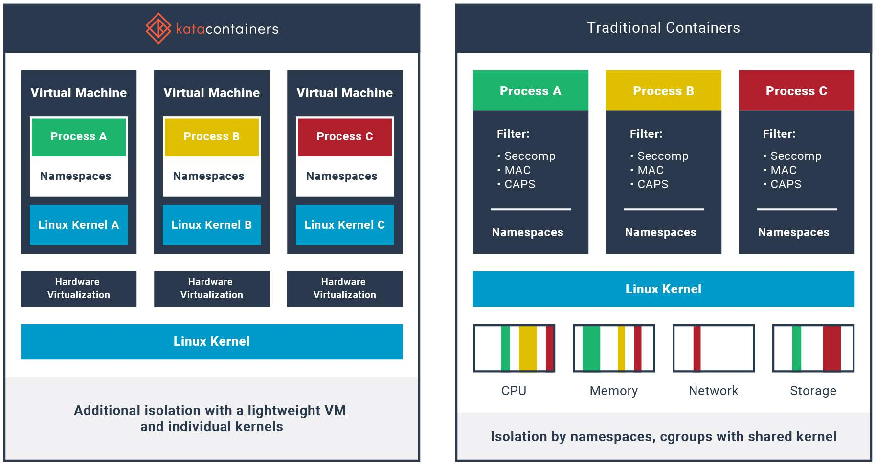
Kata containers
Virtualization Intro (Theory)
Notes:
Moat Defense

Slide 86

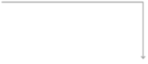


Firecracker and containerd architecture
Content
Store
Containerd
FC Snapshotter
microVM
FC Runtime
Internal FC Agent
VM Disk
Image
runc
Container
Firecracker VMM
Kernel Image

Slide 87



KATA CONTAINERS
Kubelet
CRI-O or Containerd
spec:
template: spec:
runtimeClassName: kata-fc
Annotations or RuntimeClass
runc
Kata—runtime
php php php BusyBox BusyBox BusyBox
POD POD POD
Firecracker Virtual Machine QEMU Virtual Machine

Slide 88
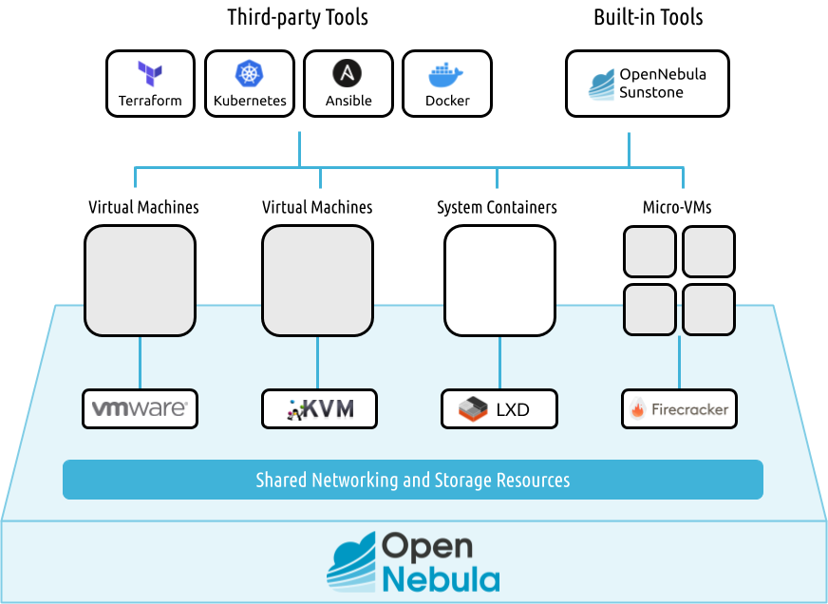
Open Nebula
Virtualization Intro (Theory)
Notes:
On premise cloud

Slide 89

Weaveworks ignite
Virtualization Intro (Theory)
Notes:
On premise cloud

Slide 90

Weaveworks ignite
Virtualization Intro (Theory)
Notes:
On premise cloud

Slide 91

Weaveworks Firekube
Virtualization Intro (Theory)
Notes:
On premise cloud

Slide 92
Weaveworks Firekube
Virtualization Intro (Theory)
Notes:
On premise cloud

Slide 93

Classic devops pipeline
Virtualization Intro (Theory)
Notes:
On premise cloud

Slide 94

Weaveworks gitops pipeline
Virtualization Intro (Theory)
Notes:
On premise cloud

Slide 95

Security boundaries
Layered VM/Container deployment unit
In \ Out communication with isolated unit
Clients APIs (firecracker sock, kubelet, ignited, etc.)
Deployment configurations (.yaml files)
DevOps communication channels
Virtualization Intro (Theory)

Slide 96
Part IV Hands on

Slide 97

LABS
Duration: 35min
Firectl (5min)
Ignite (5min)
Kata Containers (5min)
Firekube (10min)
GitOps (10min)
First step with python VM (Practice)

Slide 98
Firectl
Duration: 5min
General Explanation
Download firectl
Run VM
Exercise:
Execute ./get_latest.sh
Execute ./start.sh
Examine firectl ease of use
First step with python VM (Practice)

Slide 99
Ignite
Duration: 5min
General Explanation
Download & install ignite
Run VM like docker
Exercise:
Execute ./install_ignite.sh
Follow README.txt
First step with python VM (Practice)

Slide 100
kata
Duration: 5min
Step 1
Step 2
Step 3
First step with python VM (Practice)

Slide 101
Firekube
Duration: 10min
Step 1
Step 2
Step 3
First step with python VM (Practice)

Slide 102
gitops
Duration: 10min
Step 1
Step 2
Step 3
First step with python VM (Practice)

Slide 103
Sec & Tech Recap
Duration: 2.5min
MicroVMs are currently in their infant years
MicroVMs offer advantages over containers
MicroVMs are deployment unit in DevOps world
The more entangled in DevOps, Les secure…
Fricracker and KVM have little vulnerabilities uncovered so far
First step with python VM (Practice)

Slide 104
part IV: The end Thank you for listening !

Slide 105
Conclusion Some final words . . .

Slide 106

summary
Virtualization is awesome !
HW Assisted Virtualization ~= Native Performance
KVM - Linux Kernel as HyperVisor
HW Virt + KVM + Minimalism = MicroVMs ~= HW Isolated Container
Firecracker is the new champion
Attack Vectors → Data Transition Between Layers
Can be used to secure apps or hide malware
First step with python VM (Practice)

Slide 107
References
Vulnerabilities:
Collection of KVM exploits: search for "kvm"
https://www.exploit-db.com/
Collection of KVM vulnerabilities
https://cve.mitre.org/cgi-bin/cvekey.cgi?keyword=kvm
CVE-2019-3016: KVM PV TLB vulnerability: guest user can read memory from host and other guests: RCE, PE
https://nvd.nist.gov/vuln/detail/CVE-2019-3016
https://packetstormsecurity.com/files/157233/Kernel-Live-Patch-Security-Notice-LSN-0065-1.html
CVE-2018-12904: KVM nested virtualization vulnerability: L2 HV can execute VMX instructions: RCE, PE
https://www.exploit-db.com/exploits/44944
https://wiki.xenproject.org/wiki/Nested_Virtualization_in_Xen
CVE-2019-6974: Use after free in kvm_ioctl_create_device(): crash guest: DDoS, PE
https://nvd.nist.gov/vuln/detail/CVE-2019-6974
https://www.exploit-db.com/exploits/46388
CVE-2019-18960: vsock bufferoverflow: guest can r/w to a segment of the host-side Firecracker process: RCE, PE
https://cve.mitre.org/cgi-bin/cvename.cgi?name=CVE-2019-18960
https://nvd.nist.gov/vuln/detail/CVE-2019-18960
https://www.openwall.com/lists/oss-security/2019/12/10/1
https://www.tenable.com/cve/CVE-2019-18960
CVE-2020-2732: KVM nested virtualization vulnerability: L2 can trick L0 to accessing sensitive L1 resources: RCE, PE
https://cve.mitre.org/cgi-bin/cvename.cgi?name=CVE-2020-2732
https://wiki.xenproject.org/wiki/Nested_Virtualization_in_Xen
CVE-2019-19332: out-of-bounds mem write in 'KVM_GET_EMULATED_CPUID' ioctl(2): /dev/kvm access: DDoS.
https://cve.mitre.org/cgi-bin/cvename.cgi?name=CVE-2019-19332
https://git.kernel.org/pub/scm/linux/kernel/git/torvalds/linux.git/commit/?id=433f4ba1904100da65a311033f17a9bf586b287e
https://bugs.chromium.org/p/project-zero/issues/detail?id=1759
https://blog.cubieserver.de/2018/query-cpuid-with-inline-assembly/
https://wiki.osdev.org/CPUID
First step with python VM (Practice)

Slide 108
References
VTx:
https://xem.github.io/minix86/manual/intel-x86-and-64-manual-vol3/o_fe12b1e2a880e0ce-1961.html
https://www.felixcloutier.com/x86/vmlaunch:vmresume
https://www.intel.com/content/dam/www/public/us/en/documents/manuals/64-ia-32-architectures-software-developer-vol-3c-part-3-manual.pdf
https://lettieri.iet.unipi.it/virtualization/2016/vn05.pdf
https://www.kernel.org/doc/Documentation/virtual/kvm/nested-vmx.txt
https://www.codeproject.com/Articles/215458/Virtualization-for-System-Programmers
https://searchservervirtualization.techtarget.com/definition/Intel-VT
https://www.admin-magazine.com/Articles/Hardware-assisted-Virtualization
https://searchservervirtualization.techtarget.com/definition/hardware-assisted-virtualization
First step with python VM (Practice)

Slide 109
References
Minimal VMs from Scratch Code:
https://www.webopedia.com/TERM/M/micro-vm.html
https://www.youtube.com/playlist?list=PLSiFUSQSRYAOFwfP-aMzXJlWKVyIuWfPU
https://github.com/pbohun/stack-vm-tutorials/tree/master/stack-vm-lessons/lesson6/stack-vm
https://medium.com/@julianrunnels/google-ctf-reversing-a-program-made-of-emojis-b4c8af473278
https://github.com/google/google-ctf/blob/master/2019/beginners/reversing-emoji/attachments/vm.py
https://rayanfam.com/topics/hypervisor-from-scratch-part-1/
https://nixhacker.com/developing-hypervisior-from-scratch-part-1/
https://linuxconfig.org/how-to-create-and-manage-kvm-virtual-machines-from-cli
https://github.com/dpw/kvm-hello-world/blob/master/kvm-hello-world.c
https://github.com/soulxu/kvmsample/blob/master/main.c
https://github.com/shubham0d/ProtoVirt/blob/master/protovirt.c
https://github.com/zhou-yuxin/kvm-ept-sample/tree/master/src
https://github.com/shift-crops/EscapeMe/blob/a71768985939c7402b7303bac07e7e7ef6adb71e/kvm/main.c
https://lwn.net/Articles/658511/
https://github.com/yshalabi/kvmtest
https://docs.rs/kvm-ioctls/0.5.0/kvm_ioctls/
First step with python VM (Practice)

Slide 110
References
Types of Virtualization:
https://en.wikipedia.org/wiki/Timeline_of_virtualization_development#Year_1960
http://citeseerx.ist.psu.edu/viewdoc/download?doi=10.1.1.141.4815&rep=rep1&type=pdf
https://www.linux-kvm.org/images/3/33/02x03-NestedVirtualization.pdf
Virtualization in cloud
https://searchservervirtualization.techtarget.com/feature/Whats-the-difference-between-Type-1-and-Type-2-hypervisors
https://en.wikipedia.org/wiki/Full_virtualization
https://www.unixarena.com/2017/12/para-virtualization-full-virtualization-hardware-assisted-virtualization.html/
https://logicalread.com/virtualization-for-oracle-mc11/#.XryQbmgzaMo
http://lass.cs.umass.edu/~shenoy/courses/spring08/lectures/Lec05.pdf
https://www.cs.bgu.ac.il/~os182/wiki.files/Practical%20Session%2013%20-%20Virtualization.pdf
https://stackoverflow.com/questions/6007820/binary-translation
https://blogs.oracle.com/ravello/nested-virtualization-with-binary-translation
https://my.eng.utah.edu/~cs5460/slides/virt-lecture1.pdf
https://www.vmware.com/content/dam/digitalmarketing/vmware/en/pdf/techpaper/VMware_paravirtualization.pdf
https://medium.com/@jessgreb01/what-is-the-difference-between-a-process-a-container-and-a-vm-f36ba0f8a8f7
http://www.cs.cmu.edu/~412/lectures/L05_QEMU_BT.pdf
First step with python VM (Practice)

Slide 111
References
KVM Internals:
https://www.it610.com/article/1398546.htm
https://stackoverflow.com/questions/10922475/how-qemu-kvm-create-a-vm-thread-internally
http://www.haifux.org/lectures/312/High-Level%20Introduction%20to%20the%20Low-Level%20of%20Virtualization.pdf
https://github.com/FeelGood1337/serlMin/blob/master/Mastering%20KVM%20Virtualization-GEEKBOY.IR.pdf
https://vishnubharathi.codes/blog/kvm/
Create Ubuntu RootFS:
http://wiki.t-firefly.com/en/ROC-RK3399-PC/linux_build_ubuntu_rootfs.html
https://dev.iachieved.it/iachievedit/exploring-img-files-on-linux/
http://e2e.ti.com/support/legacy_forums/embedded/linux/f/354/t/499928?create-img-file-for-custom-image
https://tthtlc.wordpress.com/2020/01/28/how-to-create-rootfs-filesystem-for-ubuntu-18-04/
https://alpinelinux.org/downloads/
http://cdimage.ubuntu.com/cdimage/ubuntu-base/releases//18.04/release/
https://github.com/kata-containers/documentation/wiki/Initial-release-of-Kata-Containers-with-Firecracker-support
First step with python VM (Practice)

Slide 112
References
OS Internals Related to Virtualization:
https://www.youtube.com/watch?v=P_G3X69Xa0M
https://www.youtube.com/watch?v=V1TJ6b6_EjM
https://www.cs.columbia.edu/~junfeng/13fa-w4118/lectures/l06-trap.pdf
https://blog.packagecloud.io/eng/2016/04/05/the-definitive-guide-to-linux-system-calls/#what-is-a-system-call
https://montcs.bloomu.edu/Information/LowLevel/Assembly/hello-asm.html
https://gist.github.com/carloscarcamo/6833d19b726af698e62b
http://didawiki.cli.di.unipi.it/lib/exe/fetch.php/magistraleinformaticanetworking/cpa/aa1011/virt3.pdf
https://jameshfisher.com/2018/03/10/linux-assembly-hello-world/
https://www.admin-magazine.com/Archive/2014/20/Best-practices-for-KVM-on-NUMA-servers
First step with python VM (Practice)

Slide 113
References
OS Internals Related to Virtualization:
https://www.youtube.com/watch?v=P_G3X69Xa0M
https://www.youtube.com/watch?v=V1TJ6b6_EjM
https://www.cs.columbia.edu/~junfeng/13fa-w4118/lectures/l06-trap.pdf
https://blog.packagecloud.io/eng/2016/04/05/the-definitive-guide-to-linux-system-calls/#what-is-a-system-call
https://montcs.bloomu.edu/Information/LowLevel/Assembly/hello-asm.html
https://gist.github.com/carloscarcamo/6833d19b726af698e62b
http://didawiki.cli.di.unipi.it/lib/exe/fetch.php/magistraleinformaticanetworking/cpa/aa1011/virt3.pdf
https://jameshfisher.com/2018/03/10/linux-assembly-hello-world/
https://www.admin-magazine.com/Archive/2014/20/Best-practices-for-KVM-on-NUMA-servers
First step with python VM (Practice)

Slide 114
References
Firecracker:
https://lwn.net/Articles/775736/
https://www.slideshare.net/AmazonWebServices/deep-dive-into-firecracker-using-lightweight-virtual-machines-to-enhance-the-container-security-boundary-aws-summit-sydney
https://github.com/firecracker-microvm/firecracker/blob/master/docs/getting-started.md
https://blog.acolyer.org/2020/03/02/firecracker/
https://medium.com/@soham.dutta.analyst/firecracker-lightweight-virtualization-for-serverless-applications-303eea757baa
https://felixwiedmann.de/ignite/
https://opensource.com/article/19/3/rust-virtual-machine
https://github.com/bkleiner/ubuntu-firecracker
http://arun-gupta.github.io/ignite-firecracker/
https://www.weave.works/blog/fire-up-your-vms-with-weave-ignite
https://github.com/weaveworks/ignite
https://github.com/weaveworks/ignite/blob/master/docs/gitops.md
https://github.com/weaveworks/ignite/blob/master/docs/installation.md
https://github.com/luxas/ignite-gitops
https://medium.com/@s8sg/quick-start-with-firecracker-and-firectl-in-ubuntu-f58aeedae04b
https://github.com/weaveworks/ignite/blob/master/docs/FAQ.md
https://www.weave.works/blog/firekube-fast-and-secure-kubernetes-clusters-using-weave-ignite
https://github.com/ch-mk/wks-quickstart-firekube
https://thenewstack.io/weaveworks-wksctl-brings-gitops-based-fleet-management-to-kubernetes/
https://opennebula.io/opennebula-firecracker-building-the-future-of-on-premises-serverless-computing/
https://sosnowski.dev/anatomy-of-aws-lambda-ck1975g09000ijfs1fle758js
https://systemadminspro.com/google-gvisor-amazon-firecracker-openstack-kata/
First step with python VM (Practice)

Slide 115
References
Sandsifter:
https://github.com/ch-mk/sandsifter
https://www.blackhat.com/docs/us-17/thursday/us-17-Domas-Breaking-The-x86-ISA.pdf
https://stackoverflow.com/questions/41470945/relocation-r-x86-64-32s-against-data-can-not-be-used-when-making-a-shared-obj
https://github.com/xoreaxeaxeax/sandsifter/issues/2
Communication and Sandbox:
https://docs.microsoft.com/en-us/azure/architecture/patterns/sidecar
https://static.googleusercontent.com/media/research.google.com/en//pubs/archive/45406.pdf
https://pdfs.semanticscholar.org/69eb/c83c8f6b21f253f29b516fdf16101499f7b4.pdf
https://www.sdxcentral.com/products/bromium-vsentry/
http://ceur-ws.org/Vol-2508/paper-bar.pdf
https://news.sophos.com/en-us/2020/05/21/ragnar-locker-ransomware-deploys-virtual-machine-to-dodge-security/
https://www.diva-portal.org/smash/get/diva2:1214834/FULLTEXT01.pdf
https://hal.archives-ouvertes.fr/hal-00368622/document
https://www.qemu.org/docs/master/system/ivshmem.html
https://arxiv.org/abs/1909.10377
https://stackoverflow.com/questions/2101671/unix-domain-sockets-vs-shared-memory-mapped-file
https://unit42.paloaltonetworks.com/making-containers-more-isolated-an-overview-of-sandboxed-container-technologies/
First step with python VM (Practice)

Slide 116
THE END Thank you for your time

